Slide 1


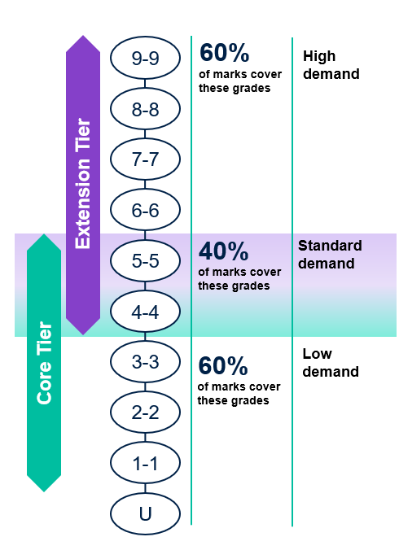
International GCSE
Combined Science (9204)
Tiering decisions for GCSE Combined Science aren't always easy, especially for potential grade 5-5 students.
Key considerations
Taking the answers to the questions below into consideration will help decide the most suitable tier for your students.
How well do students perform on the common questions in their mock exams?
How comfortable are students with maths questions in a scientific context?
How confident are students at fully understanding the required practicals and the science behind them?
Can students deal with questions where the science is in an unfamiliar context?
How resilient are students when tackling challenging questions from the start of the paper?
Have students got a good understanding of all the basic scientific concepts and phenomena?
Are their graphing skills good and can they interpret data well?
Words and terms: do they have a good understanding of them, and can they use precise scientific language?
Can your students write a coherent, logical and structured extended answer?
30% of marks are common between tiers.
These are standard demand.
There are no low demand questions on the Extension tier.

