Slide 1

Pearson Edexcel International GCSE English Language A (4EA1)
Guide to the exam papers

Slide 2
Aims and Objectives
To walk through each of the questions on the International GCSE English Language A papers and understand the requirements.
To understand the underpinning framework behind each question.
To see how you can use the papers and questions to reassure students who may be nervous about exams and to help them prepare.
The information about coursework is the ‘new format’ coursework for first submission in June 2024.
Notes:
The days 3 sessions

Slide 3
International GCSE English Language A
Component 1: Non-fiction Texts and Transactional Writing External Exam - 60% 2 hrs 15 mins (90 marks) | EITHER: Component 2: Poetry and Prose Texts and Imaginative Writing External Exam – 40% 1 hr 30 mins (60 marks) | OR: Component 3: Poetry and Prose Texts and Imaginative Writing Coursework – 40% 60 marks (1st submission June 2024)
Reading - Section A: short- and long-answer questions related to a non-fiction text from Part 1 of the Pearson Edexcel International GCSE English Anthology and one previously unseen extract. (45 marks) | Reading Section A: one 30-mark essay question on a poetry or prose text from Part 2 of the Pearson Edexcel International GCSE English Anthology. (30 marks) | Assignment A: Poetry and prose texts – one 30-mark essay question based on any three poetry or prose texts from Part 2 of the Pearson Edexcel International GCSE English Anthology. At least one poetry text and one prose text must be discussed in the assignment.
Writing - Section B: Transactional Writing – one 45-mark writing task, from a choice of two involving a given audience, form or purpose. (45 marks) | Writing Section B: Imaginative Writing – one 30-mark imaginative writing task from a choice of three. (30 marks) | Assignment B: Imaginative writing – one 30-mark imaginative writing task.

Slide 4
Assessment Objectives for Reading
 | Assessment Objective | % in International GCSE
AO1 | Read and understand a variety of texts, selecting and interpreting information, ideas and perspectives. | 15
AO2 | Understand and analyse how writers use linguistic and structural devices to achieve their effects. | 20
AO3 | Explore links and connections between writers’ ideas and perspectives, as well as how these are conveyed. | 15

Slide 5
Assessment Objectives for Writing
 | Assessment Objective | % in International GCSE
AO4 | Communicate effectively and imaginatively, adapting form, tone and register of writing for specific purposes and audiences. | 30
AO5 | Write clearly, using a range of vocabulary and sentence structures, with appropriate paragraphing and accurate spelling, grammar and punctuation. | 20

Slide 6
Paper 1: Walkthrough

Slide 7
Paper 1 – What changes and what stays the same?
Changes:
The unseen extract
The choice of anthology text
The writing questions
Stays the same:
Text 1 - unseen non-fiction
Text 2 - from Part 1 of the Anthology
timing of the paper
number of questions
structure of the questions
transactional writing
AOs being assessed
number of marks per question

Slide 8
Paper 1
Section A: Reading

Slide 9






Paper 1: Reading Facts and Figures
Section A:
The first 3 questions will always be on an unseen non-fiction text
The questions are always based on small extracts and focus on AO1
Q4 will always be based on a whole text from Part 1 of the anthology and focus on AO2
Q5 will always ask students to ‘compare’ Text 1 and Text 2
Notes:
Papers used are Nov 21, Jan 22 and June 22
Question examples are June 22

Slide 10
Paper 1 Reading: Facts and Figures
AO |  | Question
AO1 | Read and understand a variety of texts, selecting and interpreting information, ideas and perspectives. | Q1, Q2 and Q3
AO2 | Understand and analyse how writers use linguistic and structural devices to achieve their effects. | Q4
AO3 | Explore links and connections between writers’ ideas and perspectives, as well as how these are conveyed. | Q5

Slide 11
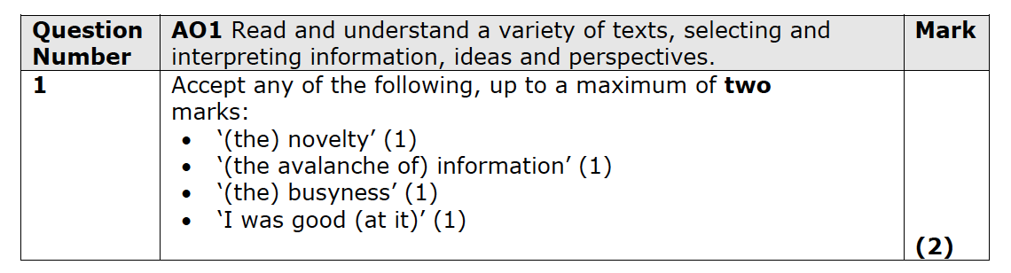
Paper 1 - Question 1
Question 1:
starts with line references
asks students to ‘select two words or phrases’
targets AO1
2 marks
can be lifted straight from the text
Notes:
Nov 21
Jan 22
June 22
MS – June 22

Slide 12
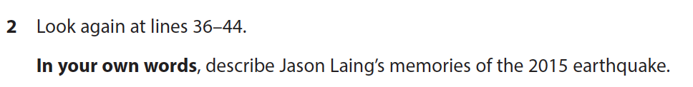
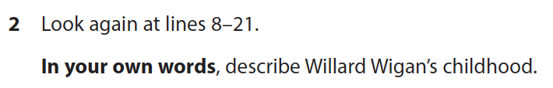
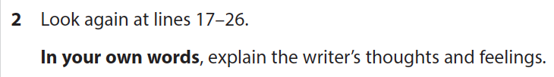
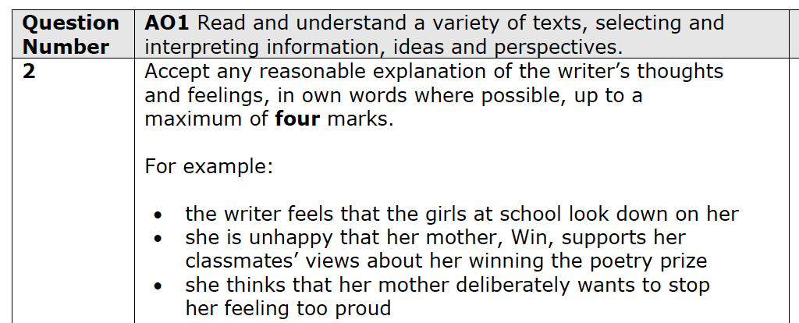
Paper 1 - Question 2
Question 2:
starts with line references
asks students to answer ‘in your own words’
targets AO1
4 marks
all relevant points made in own words and full sentences are rewarded
Notes:
Nov 21
Jan 22
June 22
MS – June 22

Slide 13
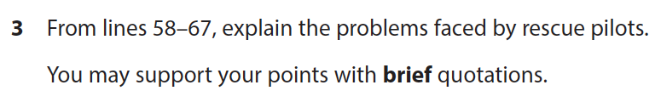
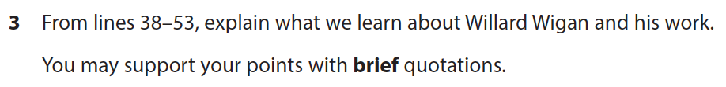
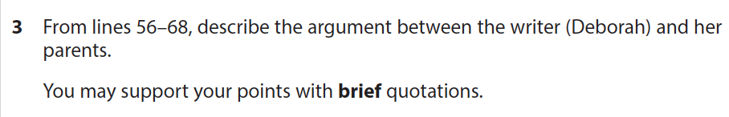
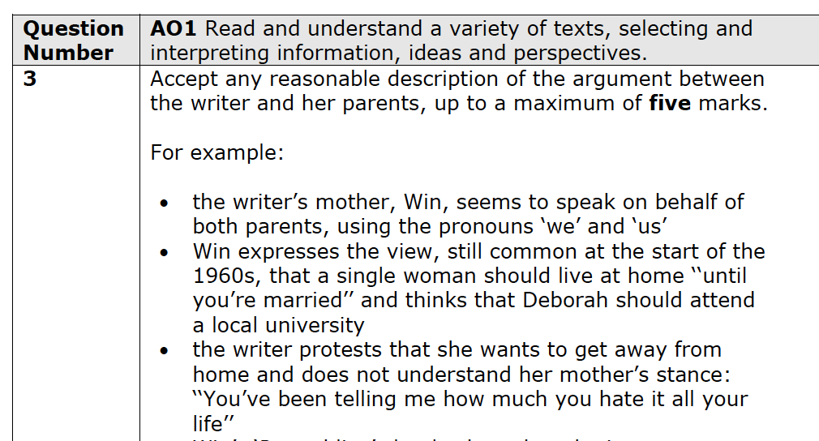
Paper 1 - Question 3
Question 3:
starts with line references
asks students to support their points with ‘brief quotations’
targets AO1
5 marks
all relevant points made in full sentences and supported by quotation are rewarded
Notes:
Nov 21
Jan 22
June 22
MS – June 22

Slide 14
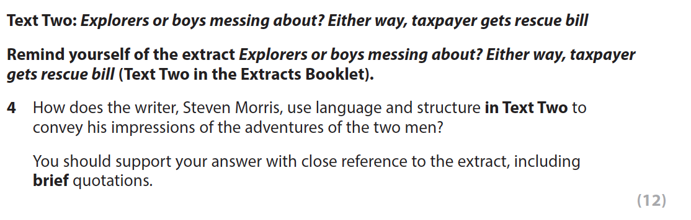
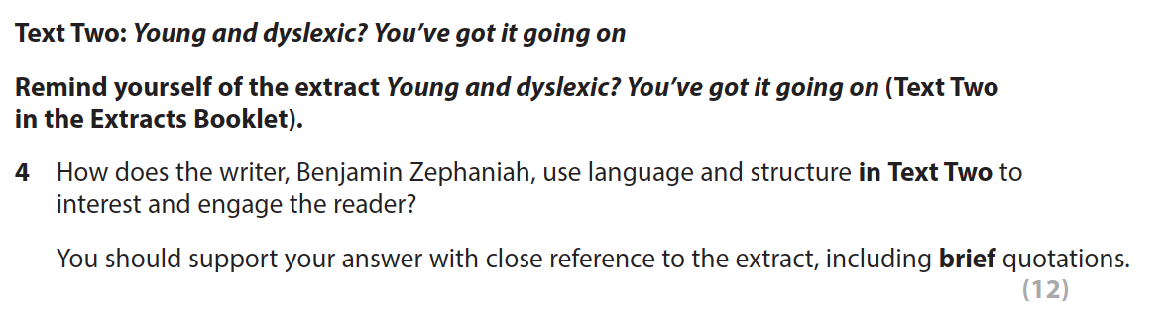
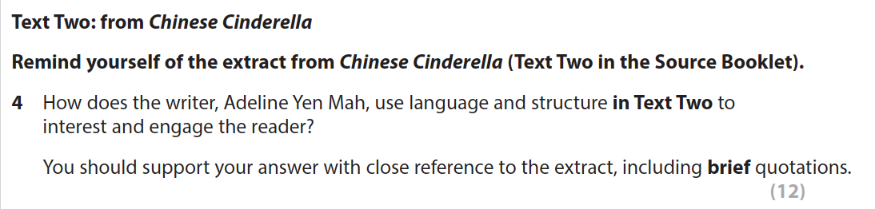
Paper 1 - Question 4
Question 4:
refers to Text 2 – the anthology text
asks ‘how does the writer…use language and structure to…’
asks students to refer to the extract and use brief quotation
12 marks
targets AO2
Notes:
Nov 21
Jan 22
June 22
MS – June 22

Slide 15
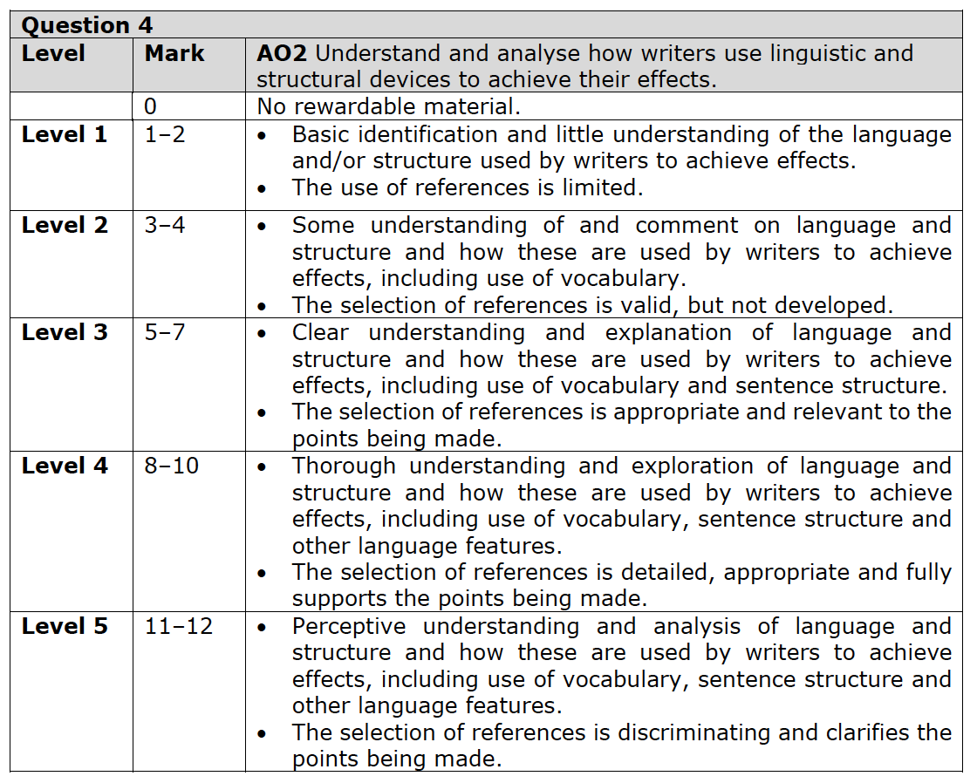
Question 4 – Mark Scheme

Slide 16
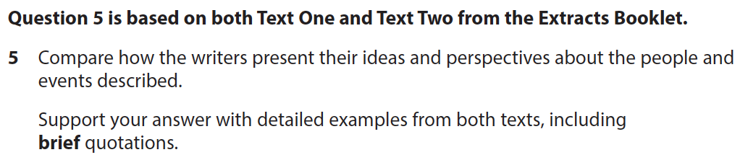
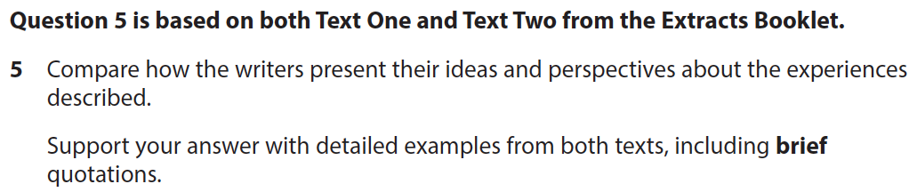
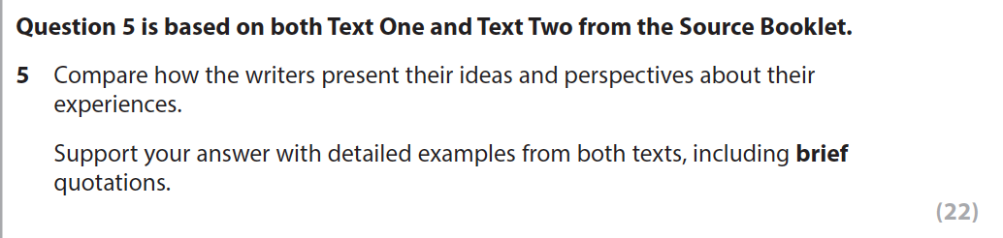
Paper 1 - Question 5
Question 5:
refers to Text 1 and Text 2
Asks students to ‘compare how the writers present their ideas and perspectives about…’
asks students to refer to both texts and use brief quotation
22 marks - students should plan and allow enough time for this question
targets AO3
Notes:
Nov 21
Jan 22
June 22
MS – June 22

Slide 17
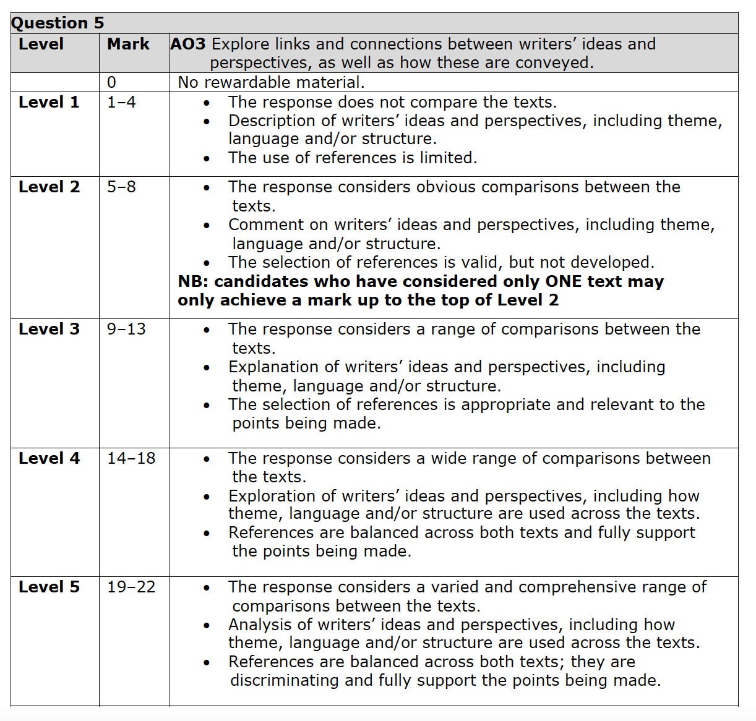
Question 5 – Mark Scheme

Slide 18
Paper 1
Section B: Writing

Slide 19
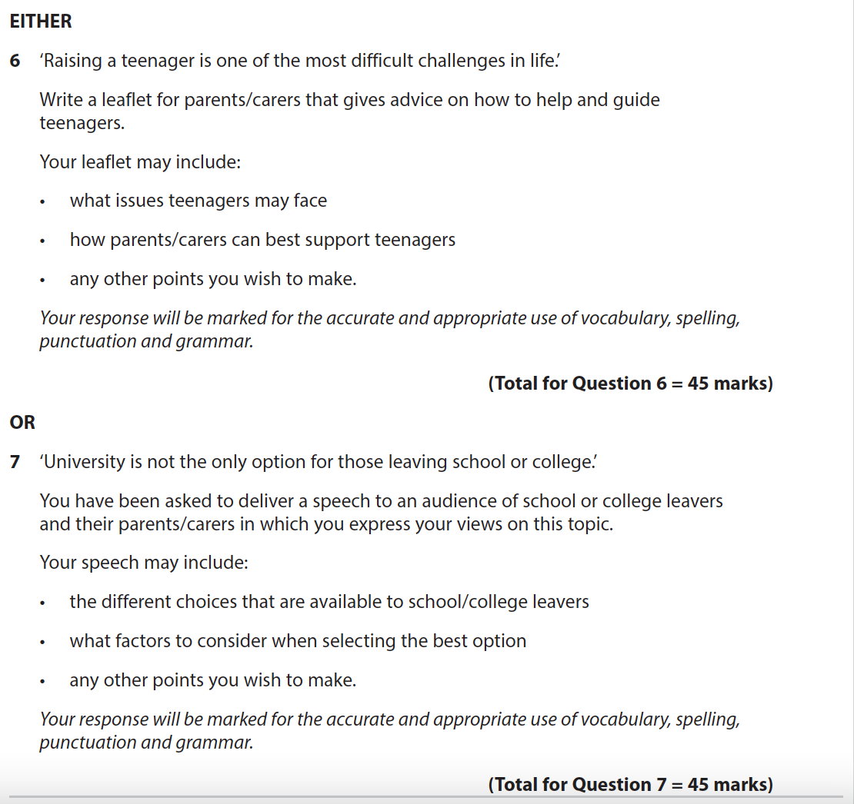
Writing Facts and Figures
Section B: The tasks will change but:
there will always be a choice of two
they will always be transactional writing tasks – the text type as well as the audience and purpose are always given in the question.
there will always be supporting bullets
Notes:
Papers used are Nov 21, Jan 22 and June 22
Question examples are June 22

Slide 20
Writing Facts and Figures
Section B: The tasks will change but:
they always remind students that the response is marked for ‘accurate and appropriate use of vocabulary, spelling, punctuation and grammar’
they will always be marked out of 45
they will always target 2 separate AOs – AO4 and AO5
Notes:
Papers used are Nov 21, Jan 22 and June 22
Question examples are June 22

Slide 21
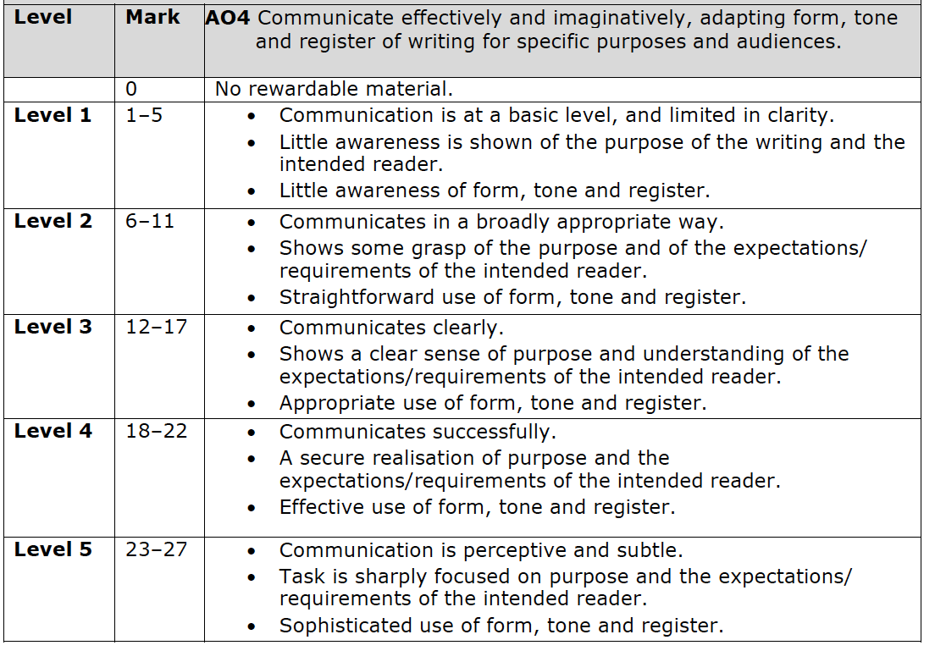
Question 6 and 7 – Mark Scheme – AO4

Slide 22
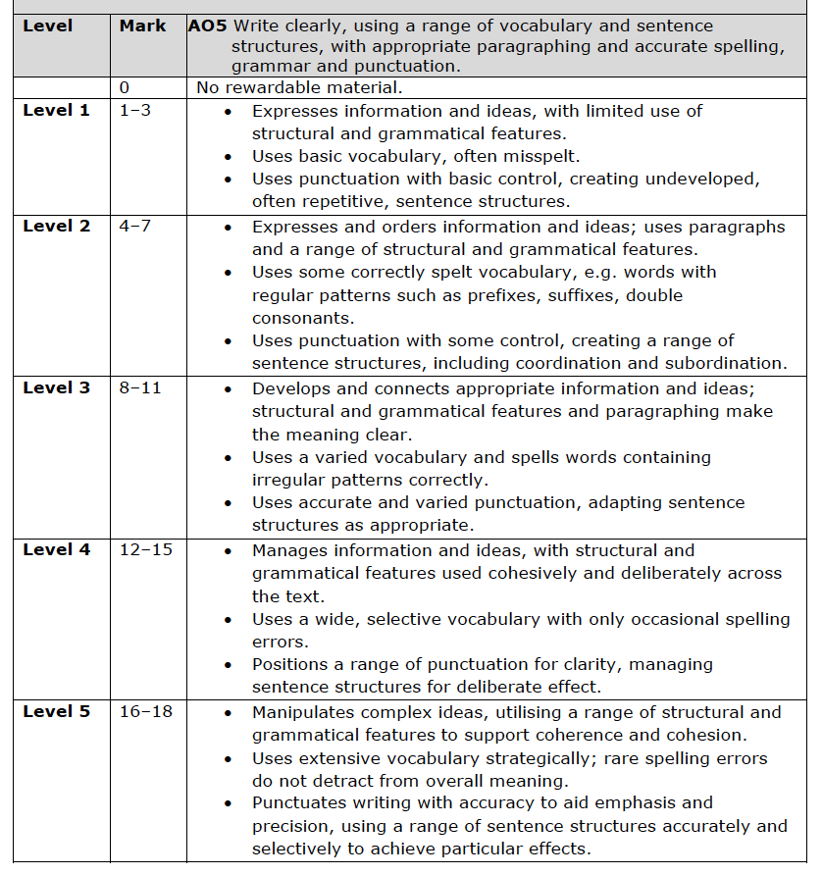
Question 6 and 7 – Mark Scheme – AO5

Slide 23
Paper 2: Walkthrough

Slide 24
Paper 2 – What changes and what stays the same?
Changes:
The choice of anthology text
The writing questions
Stays the same:
the text will always come from Part 2 of the anthology
timing of the paper
number of questions
structure of the questions
imaginative writing
AOs being assessed
number of marks per question

Slide 25
Paper 2
Section A: Reading

Slide 26
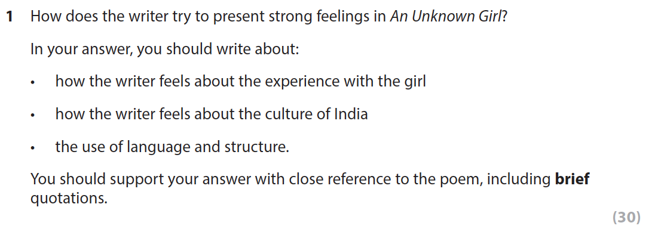
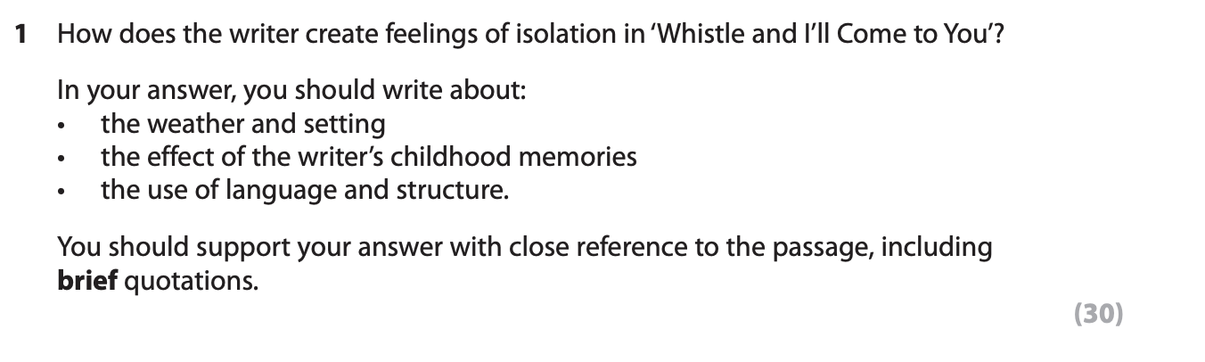
Paper 2: Reading Facts and Figures
Section A:
The question will always be on one of the prose or poetry texts from Part 2 of the anthology
The questions are always based on the whole text and focus on AO1 and AO2
Notes:
Papers used are Jan 22, June 22 and SAMs
Question examples are June 22 and SAMs

Slide 27
Paper 2 Reading: Facts and Figures
AO |  | Question
AO1 | Read and understand a variety of texts, selecting and interpreting information, ideas and perspectives. | Q1
AO2 | Understand and analyse how writers use linguistic and structural devices to achieve their effects. | Q1

Slide 28
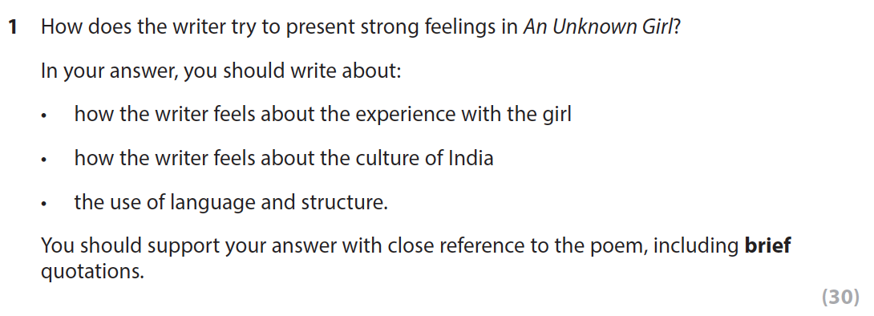
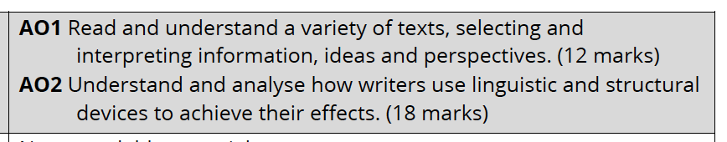
Paper 2 - Question 1
Question 1:
starts with ‘how does the writer…’
asks about the whole text
has supporting bullets
asks students to refer to the text and use brief quotation
30 marks
targets AO1 and AO2
Notes:
June 22
SAMs

Slide 29
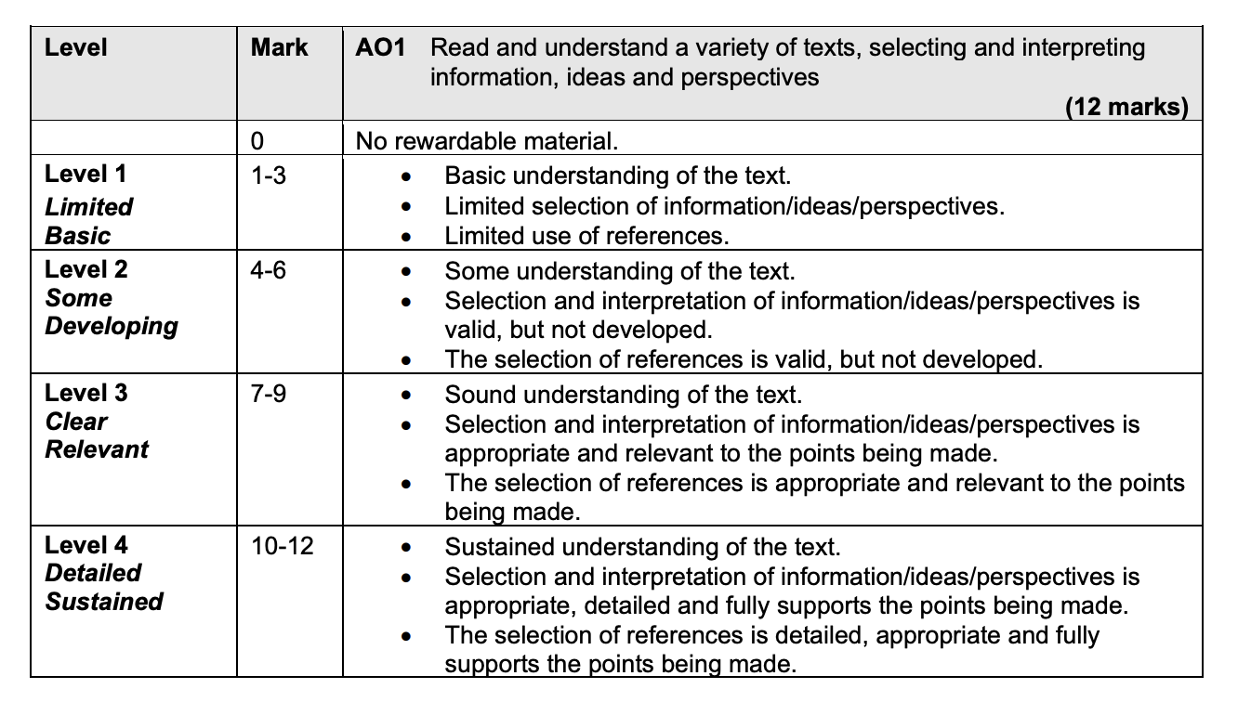
Question 1 – Mark Scheme - AO1

Slide 30
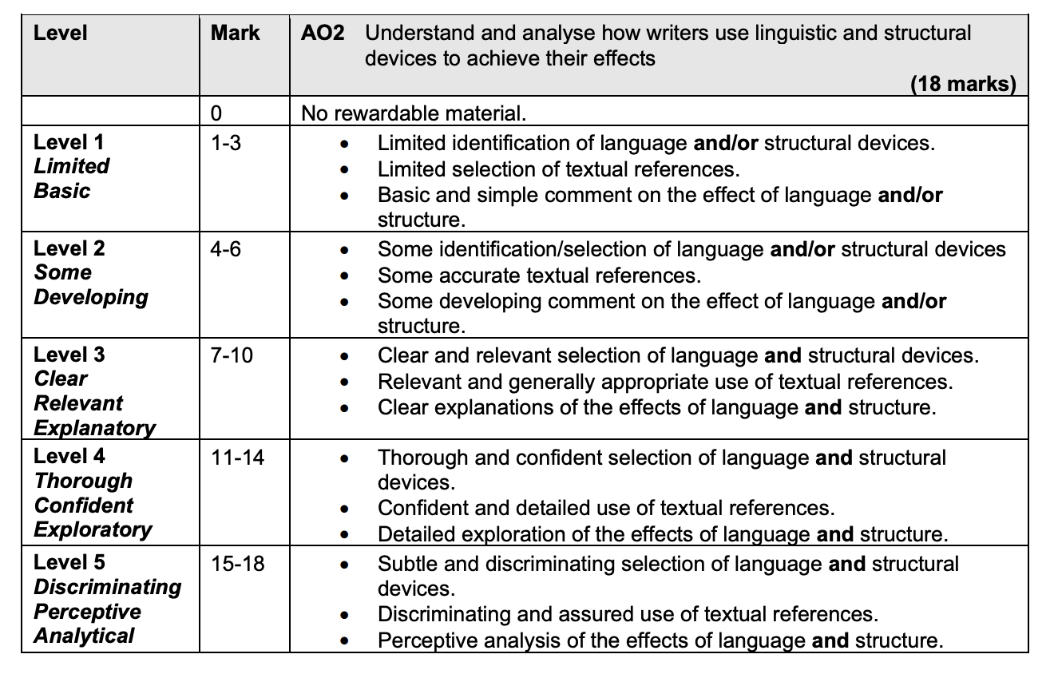
Question 1 – Mark Scheme - AO2

Slide 31
Paper 2
Section B: Writing

Slide 32
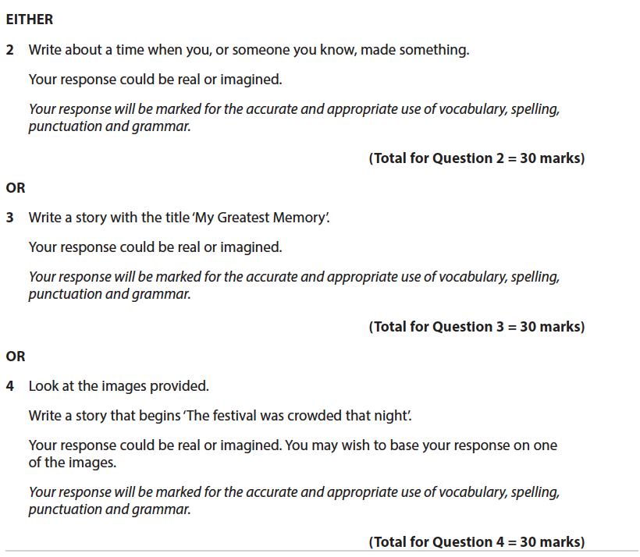
Writing Facts and Figures
Section B: The tasks will change but:
there will always be a choice of three
they will always be imaginative writing tasks
one of the questions will always have some images to help students
Notes:
Papers used are Nov 21, Jan 22 and June 22
Question examples are June 22

Slide 33
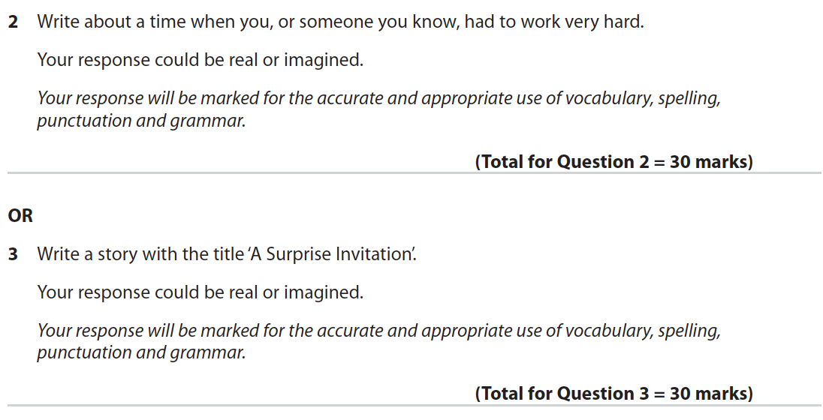
Writing Facts and Figures
Section B: The tasks will change but:
they always remind students that the response is marked for ‘accurate and appropriate use of vocabulary, spelling, punctuation and grammar’
they will always be marked out of 30
they will always target 2 separate AOs – AO4 and AO5
Notes:
Papers used are Nov 21, Jan 22 and June 22
Question examples are June 22

Slide 34
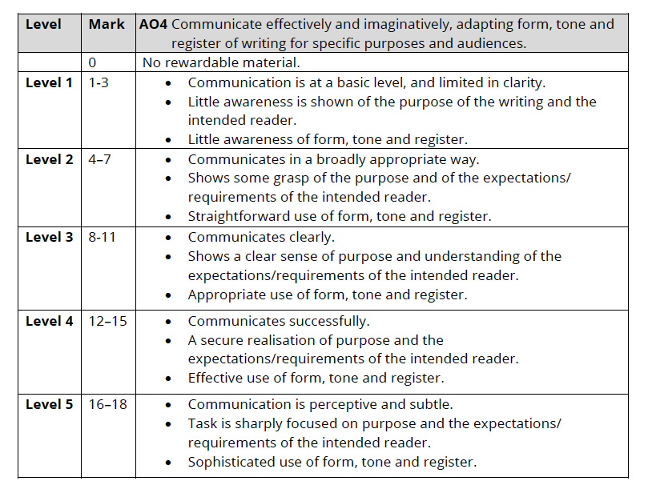
Questions 2, 3 & 4 – Mark Scheme – AO4

Slide 35
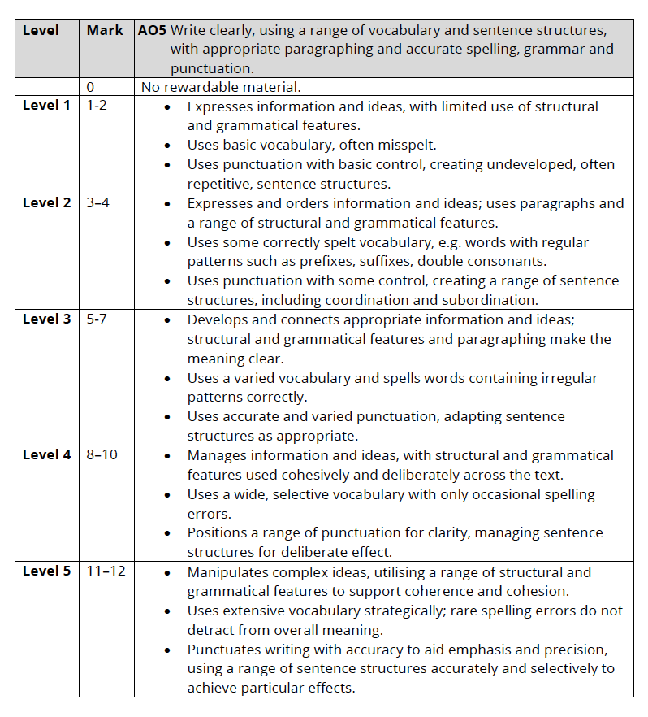
Questions 2, 3 & 4 – Mark Scheme – AO5

Slide 36
Support

Slide 37
Where to find the past papers
You can download all of our past papers from the website (the most recent with your Edexcel Online login):
In this presentation, we have used examples from the SAMs, Nov 21, Jan 22 and June 22
All other past papers can be found in the exam materials area on the website
There are also some specimen papers in the teaching and learning materials area on the website
Summary documents of the questions from all series can be found in the teaching and learning materials area on the website
For all queries, please contact Clare Haviland on TeachingEnglish@Pearson.com, https://support.pearson.com/uk/s/qualification-contactus, or LinkedIn.
Notes:
Papers used are the SAMs, Nov 21, Jan 22 and June 22
Question examples are June 22

Slide 38
Thank you!

