Slide 1
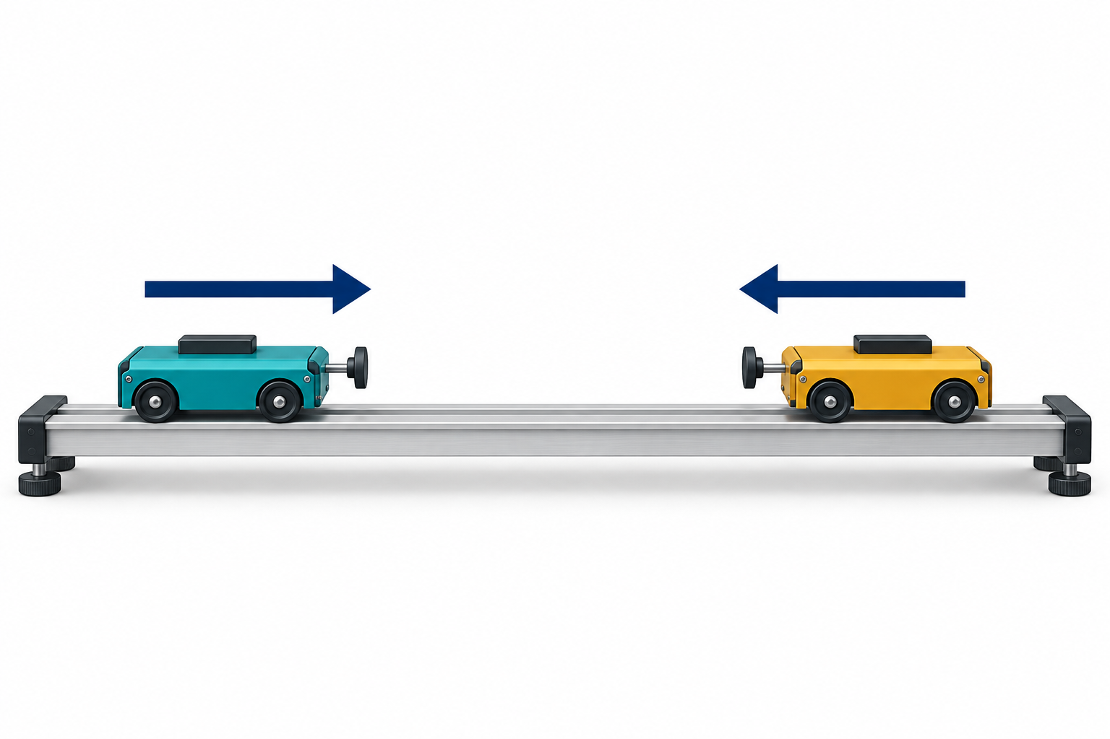
TOPIC 1.1
AP PHYSICS 1 1.1
Scalars and Vectors in One Dimension
TOPIC 1.1
Same speed.
Opposite directions.
Do the carts have
the same velocity?
Think before the next slide.
Topic introduction / 1.1
jimlaoshi.com
1
Notes:
AP Physics 1: Algebra-Based. Topic 1.1, Scalars and Vectors in One Dimension. College Board Course and Exam Description, effective Fall 2024, current ©2026 copy, Course Framework V.1, printed p.27 (PDF page34). Official source: https://apcentral.collegeboard.org/media/pdf/ap-physics-1-course-and-exam-description.pdf . Clarifications implemented Fall2026: https://apcentral.collegeboard.org/media/pdf/ap-physics-1-course-and-exam-description-clarifications.pdf . Relevant objectives 1.1.A and1.1.B. Numerical questions, examples and explanations are original Jimlaoshi teaching material, not official AP examination questions. Scope: one-dimensional vectors, scalar/vector classification, arrow representations, notation, signed components and sums. Rates of change, full kinematics calculations and two-dimensional resolution belong to later topics. Style reference: /Users/1mdollars/Desktop/Jimlaoshivideos/output/IAL_Physics_All_Hints_Labelled_20261023/deliverables/Jimlaoshi_IAL_Physics_1_2_2_Hints_Labelled.pptx. Illustration: carts-cover.png. Built-in OpenAI image generation, 26 October2026, conceptual laboratory-cart illustration. Opening question: the arrows model equal speeds in opposite directions. Equal speed does not imply equal velocity. Discuss before the definition slide.

Slide 2
CONCEPT 1
AP PHYSICS 1 1.1
Scalar and vector quantities
KEY TERMS
Magnitude
Scalar
The size of a quantity, with an appropriate unit.
A quantity described by its
magnitude.
Scalar examples
Distance and speed.
Vector
A quantity described by
magnitude and direction.
Vector examples
Position, displacement, velocity and acceleration.
Topic 1.1 / 1 / Definitions and symbols
jimlaoshi.com
2
Notes:
AP Physics 1: Algebra-Based. Topic 1.1, Scalars and Vectors in One Dimension. College Board Course and Exam Description, effective Fall 2024, current ©2026 copy, Course Framework V.1, printed p.27 (PDF page34). Official source: https://apcentral.collegeboard.org/media/pdf/ap-physics-1-course-and-exam-description.pdf . Clarifications implemented Fall2026: https://apcentral.collegeboard.org/media/pdf/ap-physics-1-course-and-exam-description-clarifications.pdf . Relevant objectives 1.1.A and1.1.B. Numerical questions, examples and explanations are original Jimlaoshi teaching material, not official AP examination questions. Scope: one-dimensional vectors, scalar/vector classification, arrow representations, notation, signed components and sums. Rates of change, full kinematics calculations and two-dimensional resolution belong to later topics. Style reference: /Users/1mdollars/Desktop/Jimlaoshivideos/output/IAL_Physics_All_Hints_Labelled_20261023/deliverables/Jimlaoshi_IAL_Physics_1_2_2_Hints_Labelled.pptx.

Slide 3
QUESTION 1
AP PHYSICS 1 1.1
Which descriptions need a direction?
DESCRIPTIONS
(a) Classify each listed quantity as scalar or
vector.
Distance: 12 m
(b) A student writes “velocity = 3 m/s”. What
information is missing?
Speed: 3 m/s
Velocity: 3 m/s west
(c) Two carts move at 3 m/s in opposite directions.
Compare their speeds and velocities.
Displacement: 12 m east
Topic 1.1 / 1 / Question
jimlaoshi.com
3
Notes:
AP Physics 1: Algebra-Based. Topic 1.1, Scalars and Vectors in One Dimension. College Board Course and Exam Description, effective Fall 2024, current ©2026 copy, Course Framework V.1, printed p.27 (PDF page34). Official source: https://apcentral.collegeboard.org/media/pdf/ap-physics-1-course-and-exam-description.pdf . Clarifications implemented Fall2026: https://apcentral.collegeboard.org/media/pdf/ap-physics-1-course-and-exam-description-clarifications.pdf . Relevant objectives 1.1.A and1.1.B. Numerical questions, examples and explanations are original Jimlaoshi teaching material, not official AP examination questions. Scope: one-dimensional vectors, scalar/vector classification, arrow representations, notation, signed components and sums. Rates of change, full kinematics calculations and two-dimensional resolution belong to later topics. Style reference: /Users/1mdollars/Desktop/Jimlaoshivideos/output/IAL_Physics_All_Hints_Labelled_20261023/deliverables/Jimlaoshi_IAL_Physics_1_2_2_Hints_Labelled.pptx. Keep the next answer slide hidden while students attempt every part.

Slide 4
ANSWER 1
AP PHYSICS 1 1.1
Which descriptions need a direction?
(a) Quantity | Type | Information
Distance | Scalar | 12 m
Speed | Scalar | 3 m/s
Velocity | Vector | 3 m/s west
Displacement | Vector | 12 m east
(b) The direction is missing
(c) Same speed, different velocities
A complete velocity description includes both
speed and direction.
Both speeds are 3 m/s. Their velocity
directions are opposite.
Topic 1.1 / 1 / Key and explanation
jimlaoshi.com
4
Notes:
AP Physics 1: Algebra-Based. Topic 1.1, Scalars and Vectors in One Dimension. College Board Course and Exam Description, effective Fall 2024, current ©2026 copy, Course Framework V.1, printed p.27 (PDF page34). Official source: https://apcentral.collegeboard.org/media/pdf/ap-physics-1-course-and-exam-description.pdf . Clarifications implemented Fall2026: https://apcentral.collegeboard.org/media/pdf/ap-physics-1-course-and-exam-description-clarifications.pdf . Relevant objectives 1.1.A and1.1.B. Numerical questions, examples and explanations are original Jimlaoshi teaching material, not official AP examination questions. Scope: one-dimensional vectors, scalar/vector classification, arrow representations, notation, signed components and sums. Rates of change, full kinematics calculations and two-dimensional resolution belong to later topics. Style reference: /Users/1mdollars/Desktop/Jimlaoshivideos/output/IAL_Physics_All_Hints_Labelled_20261023/deliverables/Jimlaoshi_IAL_Physics_1_2_2_Hints_Labelled.pptx.

Slide 5
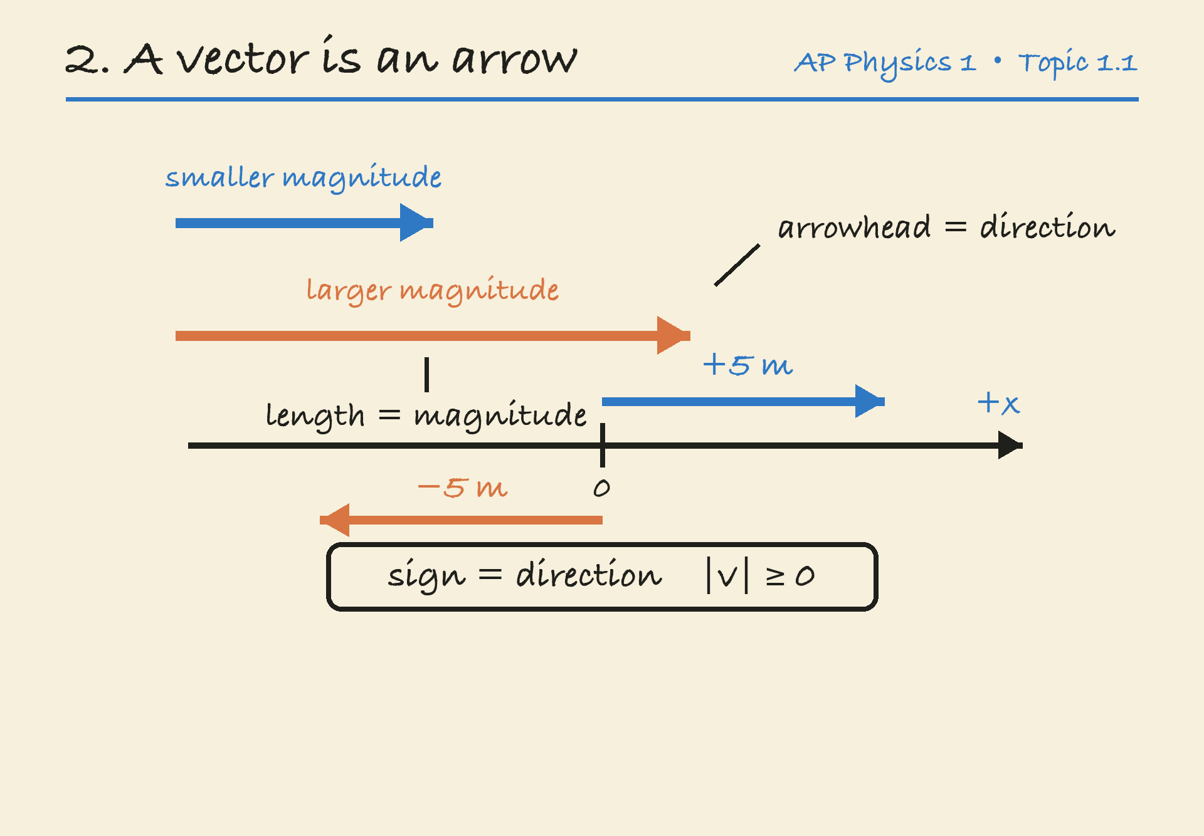
CONCEPT 2
AP PHYSICS 1 1.1
Arrows represent vectors
Arrowhead
Shows direction.
Arrow length
Proportional to magnitude at
a fixed scale.
Double the length means double
the magnitude.
Topic 1.1 / 2 / Definitions and symbols
jimlaoshi.com
5
Notes:
AP Physics 1: Algebra-Based. Topic 1.1, Scalars and Vectors in One Dimension. College Board Course and Exam Description, effective Fall 2024, current ©2026 copy, Course Framework V.1, printed p.27 (PDF page34). Official source: https://apcentral.collegeboard.org/media/pdf/ap-physics-1-course-and-exam-description.pdf . Clarifications implemented Fall2026: https://apcentral.collegeboard.org/media/pdf/ap-physics-1-course-and-exam-description-clarifications.pdf . Relevant objectives 1.1.A and1.1.B. Numerical questions, examples and explanations are original Jimlaoshi teaching material, not official AP examination questions. Scope: one-dimensional vectors, scalar/vector classification, arrow representations, notation, signed components and sums. Rates of change, full kinematics calculations and two-dimensional resolution belong to later topics. Style reference: /Users/1mdollars/Desktop/Jimlaoshivideos/output/IAL_Physics_All_Hints_Labelled_20261023/deliverables/Jimlaoshi_IAL_Physics_1_2_2_Hints_Labelled.pptx. Illustration: D02_vector_arrow_and_signed_axis.png. Existing Jimlaoshi AP Physics1 Topic1.1 visual supplied by the local course workspace. Original figure retained.

Slide 6
QUESTION 2
AP PHYSICS 1 1.1
Drawing displacement vectors to scale
GIVEN
(a) Draw arrows for A and B using the stated
scale. Label their lengths in centimetres.
A: 6 m to the left
(b) Compare the magnitudes of A and B.
B: 3 m to the right
(c) A student draws both arrows to the same
length. Explain the error.
Scale: 1 cm represents 2 m
Hint: Divide each magnitude by the metres per centimetre.
Topic 1.1 / 2 / Question
jimlaoshi.com
6
Notes:
AP Physics 1: Algebra-Based. Topic 1.1, Scalars and Vectors in One Dimension. College Board Course and Exam Description, effective Fall 2024, current ©2026 copy, Course Framework V.1, printed p.27 (PDF page34). Official source: https://apcentral.collegeboard.org/media/pdf/ap-physics-1-course-and-exam-description.pdf . Clarifications implemented Fall2026: https://apcentral.collegeboard.org/media/pdf/ap-physics-1-course-and-exam-description-clarifications.pdf . Relevant objectives 1.1.A and1.1.B. Numerical questions, examples and explanations are original Jimlaoshi teaching material, not official AP examination questions. Scope: one-dimensional vectors, scalar/vector classification, arrow representations, notation, signed components and sums. Rates of change, full kinematics calculations and two-dimensional resolution belong to later topics. Style reference: /Users/1mdollars/Desktop/Jimlaoshivideos/output/IAL_Physics_All_Hints_Labelled_20261023/deliverables/Jimlaoshi_IAL_Physics_1_2_2_Hints_Labelled.pptx. Keep the next answer slide hidden while students attempt every part.

Slide 7
ANSWER 2
AP PHYSICS 1 1.1
Drawing displacement vectors to scale
WORKED ANSWER
(a) Arrow lengths at the stated scale
A: 6 ÷ 2 = 3 cm, pointing left.
B: 3 ÷ 2 = 1.5 cm, pointing right.
A: 3 cm left
B: 1.5 cm right
(b) A has twice the magnitude of B
6 m is twice 3 m.
Magnitude ratio: 2 : 1
(c) Equal lengths show equal magnitudes
At this scale, A must be twice as long as B. Reversing
direction changes the arrowhead.
Topic 1.1 / 2 / Key and explanation
jimlaoshi.com
7
Notes:
AP Physics 1: Algebra-Based. Topic 1.1, Scalars and Vectors in One Dimension. College Board Course and Exam Description, effective Fall 2024, current ©2026 copy, Course Framework V.1, printed p.27 (PDF page34). Official source: https://apcentral.collegeboard.org/media/pdf/ap-physics-1-course-and-exam-description.pdf . Clarifications implemented Fall2026: https://apcentral.collegeboard.org/media/pdf/ap-physics-1-course-and-exam-description-clarifications.pdf . Relevant objectives 1.1.A and1.1.B. Numerical questions, examples and explanations are original Jimlaoshi teaching material, not official AP examination questions. Scope: one-dimensional vectors, scalar/vector classification, arrow representations, notation, signed components and sums. Rates of change, full kinematics calculations and two-dimensional resolution belong to later topics. Style reference: /Users/1mdollars/Desktop/Jimlaoshivideos/output/IAL_Physics_All_Hints_Labelled_20261023/deliverables/Jimlaoshi_IAL_Physics_1_2_2_Hints_Labelled.pptx.

Slide 8
CONCEPT 3
AP PHYSICS 1 1.1
Signs describe direction along an axis
KEY TERMS
Signed component
Right is positive
In one dimension, the sign specifies direction
relative to the chosen positive axis.
+5 m means 5 m right.
−5 m means 5 m left.
A different choice of positive direction
Reversing the positive axis reverses the
component signs. The physical directions stay the
same.
Both magnitudes are 5 m.
Hint: State the positive direction before assigning signs.
Topic 1.1 / 3 / Definitions and symbols
jimlaoshi.com
8
Notes:
AP Physics 1: Algebra-Based. Topic 1.1, Scalars and Vectors in One Dimension. College Board Course and Exam Description, effective Fall 2024, current ©2026 copy, Course Framework V.1, printed p.27 (PDF page34). Official source: https://apcentral.collegeboard.org/media/pdf/ap-physics-1-course-and-exam-description.pdf . Clarifications implemented Fall2026: https://apcentral.collegeboard.org/media/pdf/ap-physics-1-course-and-exam-description-clarifications.pdf . Relevant objectives 1.1.A and1.1.B. Numerical questions, examples and explanations are original Jimlaoshi teaching material, not official AP examination questions. Scope: one-dimensional vectors, scalar/vector classification, arrow representations, notation, signed components and sums. Rates of change, full kinematics calculations and two-dimensional resolution belong to later topics. Style reference: /Users/1mdollars/Desktop/Jimlaoshivideos/output/IAL_Physics_All_Hints_Labelled_20261023/deliverables/Jimlaoshi_IAL_Physics_1_2_2_Hints_Labelled.pptx.

Slide 9
QUESTION 3
AP PHYSICS 1 1.1
An elevator and an upward-positive axis
GIVEN
(a) State the elevator’s speed and direction of
motion.
Positive direction: upward
(b) Describe the same velocity when downward is
chosen as positive.
Velocity component = −2 m/s
(c) Does the negative velocity prove that the
elevator is below the origin? Explain.
Position is not supplied.
Topic 1.1 / 3 / Question
jimlaoshi.com
9
Notes:
AP Physics 1: Algebra-Based. Topic 1.1, Scalars and Vectors in One Dimension. College Board Course and Exam Description, effective Fall 2024, current ©2026 copy, Course Framework V.1, printed p.27 (PDF page34). Official source: https://apcentral.collegeboard.org/media/pdf/ap-physics-1-course-and-exam-description.pdf . Clarifications implemented Fall2026: https://apcentral.collegeboard.org/media/pdf/ap-physics-1-course-and-exam-description-clarifications.pdf . Relevant objectives 1.1.A and1.1.B. Numerical questions, examples and explanations are original Jimlaoshi teaching material, not official AP examination questions. Scope: one-dimensional vectors, scalar/vector classification, arrow representations, notation, signed components and sums. Rates of change, full kinematics calculations and two-dimensional resolution belong to later topics. Style reference: /Users/1mdollars/Desktop/Jimlaoshivideos/output/IAL_Physics_All_Hints_Labelled_20261023/deliverables/Jimlaoshi_IAL_Physics_1_2_2_Hints_Labelled.pptx. Keep the next answer slide hidden while students attempt every part.

Slide 10
ANSWER 3
AP PHYSICS 1 1.1
An elevator and an upward-positive axis
WORKED ANSWER
(a) Magnitude and direction
The speed is 2 m/s. The negative component
means downward because upward is positive.
Speed = 2 m/s
Motion: downward
(b) Same motion with downward positive
The component becomes +2 m/s. The elevator still
moves downward.
With downward positive:
component = +2 m/s
(c) Velocity does not locate the elevator
No. Position is a separate quantity.
Topic 1.1 / 3 / Key and explanation
jimlaoshi.com
10
Notes:
AP Physics 1: Algebra-Based. Topic 1.1, Scalars and Vectors in One Dimension. College Board Course and Exam Description, effective Fall 2024, current ©2026 copy, Course Framework V.1, printed p.27 (PDF page34). Official source: https://apcentral.collegeboard.org/media/pdf/ap-physics-1-course-and-exam-description.pdf . Clarifications implemented Fall2026: https://apcentral.collegeboard.org/media/pdf/ap-physics-1-course-and-exam-description-clarifications.pdf . Relevant objectives 1.1.A and1.1.B. Numerical questions, examples and explanations are original Jimlaoshi teaching material, not official AP examination questions. Scope: one-dimensional vectors, scalar/vector classification, arrow representations, notation, signed components and sums. Rates of change, full kinematics calculations and two-dimensional resolution belong to later topics. Style reference: /Users/1mdollars/Desktop/Jimlaoshivideos/output/IAL_Physics_All_Hints_Labelled_20261023/deliverables/Jimlaoshi_IAL_Physics_1_2_2_Hints_Labelled.pptx.

Slide 11
CONCEPT 4
AP PHYSICS 1 1.1
Vector notation and signed components
NOTATION
Component notation
An arrow over a symbol
A component such as vₓ needs no vector arrow.
Its sign gives its direction along the chosen axis.
→
v
means the velocity vector.
Magnitude
Speed = |vₓ|
vₓ is its signed component
along the x-axis.
If vₓ = −4 m/s, the speed is 4 m/s.
Topic 1.1 / 4 / Definitions and symbols
jimlaoshi.com
11
Notes:
AP Physics 1: Algebra-Based. Topic 1.1, Scalars and Vectors in One Dimension. College Board Course and Exam Description, effective Fall 2024, current ©2026 copy, Course Framework V.1, printed p.27 (PDF page34). Official source: https://apcentral.collegeboard.org/media/pdf/ap-physics-1-course-and-exam-description.pdf . Clarifications implemented Fall2026: https://apcentral.collegeboard.org/media/pdf/ap-physics-1-course-and-exam-description-clarifications.pdf . Relevant objectives 1.1.A and1.1.B. Numerical questions, examples and explanations are original Jimlaoshi teaching material, not official AP examination questions. Scope: one-dimensional vectors, scalar/vector classification, arrow representations, notation, signed components and sums. Rates of change, full kinematics calculations and two-dimensional resolution belong to later topics. Style reference: /Users/1mdollars/Desktop/Jimlaoshivideos/output/IAL_Physics_All_Hints_Labelled_20261023/deliverables/Jimlaoshi_IAL_Physics_1_2_2_Hints_Labelled.pptx. CED notation examples: vector equation v⃗ = v⃗₀ + a⃗t and component equation vₓ = vₓ₀ + aₓt. These illustrate vector versus component notation only. Full kinematics and acceleration calculations are deferred. The vector-overarrow on this slide is editable text placed above the variable.

Slide 12
QUESTION 4
AP PHYSICS 1 1.1
Reading vector and component notation
GIVEN
(a) State each cart’s speed and direction.
The x-axis points east.
(b) Explain why vₓ can be written without an arrow
above it.
Cart P: vₓ = −4 m/s
(c) For east chosen as positive, which expression
gives speed: vₓ or |vₓ|? Explain using cart P.
Cart Q: vₓ = +4 m/s
Topic 1.1 / 4 / Question
jimlaoshi.com
12
Notes:
AP Physics 1: Algebra-Based. Topic 1.1, Scalars and Vectors in One Dimension. College Board Course and Exam Description, effective Fall 2024, current ©2026 copy, Course Framework V.1, printed p.27 (PDF page34). Official source: https://apcentral.collegeboard.org/media/pdf/ap-physics-1-course-and-exam-description.pdf . Clarifications implemented Fall2026: https://apcentral.collegeboard.org/media/pdf/ap-physics-1-course-and-exam-description-clarifications.pdf . Relevant objectives 1.1.A and1.1.B. Numerical questions, examples and explanations are original Jimlaoshi teaching material, not official AP examination questions. Scope: one-dimensional vectors, scalar/vector classification, arrow representations, notation, signed components and sums. Rates of change, full kinematics calculations and two-dimensional resolution belong to later topics. Style reference: /Users/1mdollars/Desktop/Jimlaoshivideos/output/IAL_Physics_All_Hints_Labelled_20261023/deliverables/Jimlaoshi_IAL_Physics_1_2_2_Hints_Labelled.pptx. Keep the next answer slide hidden while students attempt every part.

Slide 13
ANSWER 4
AP PHYSICS 1 1.1
Reading vector and component notation
(a) Cart | Velocity component | Speed and direction
P | −4 m/s | 4 m/s west
Q | +4 m/s | 4 m/s east
(b) The axis and sign specify direction
(c) Speed is the magnitude |vₓ|
The subscript x identifies the component. Its
sign gives the direction along that axis.
For P, |−4| = 4 m/s. The signed component
−4 m/s includes direction.
Topic 1.1 / 4 / Key and explanation
jimlaoshi.com
13
Notes:
AP Physics 1: Algebra-Based. Topic 1.1, Scalars and Vectors in One Dimension. College Board Course and Exam Description, effective Fall 2024, current ©2026 copy, Course Framework V.1, printed p.27 (PDF page34). Official source: https://apcentral.collegeboard.org/media/pdf/ap-physics-1-course-and-exam-description.pdf . Clarifications implemented Fall2026: https://apcentral.collegeboard.org/media/pdf/ap-physics-1-course-and-exam-description-clarifications.pdf . Relevant objectives 1.1.A and1.1.B. Numerical questions, examples and explanations are original Jimlaoshi teaching material, not official AP examination questions. Scope: one-dimensional vectors, scalar/vector classification, arrow representations, notation, signed components and sums. Rates of change, full kinematics calculations and two-dimensional resolution belong to later topics. Style reference: /Users/1mdollars/Desktop/Jimlaoshivideos/output/IAL_Physics_All_Hints_Labelled_20261023/deliverables/Jimlaoshi_IAL_Physics_1_2_2_Hints_Labelled.pptx.

Slide 14
CONCEPT 5
AP PHYSICS 1 1.1
Adding vectors in one dimension
VECTOR SUM
Opposite directions have opposite signs
Resultant
Vector components add algebraically. Equal
components in opposite directions cancel.
The single vector equal to the
vector sum.
Hint: Choose one positive direction for every vector.
+8 m + (−3 m) = +5 m
Hint: For a diagram, place each new tail at the previous
arrowhead.
Resultant: 5 m right
Hint: The resultant runs from the first tail to the final arrowhead.
Topic 1.1 / 5 / Definitions and symbols
jimlaoshi.com
14
Notes:
AP Physics 1: Algebra-Based. Topic 1.1, Scalars and Vectors in One Dimension. College Board Course and Exam Description, effective Fall 2024, current ©2026 copy, Course Framework V.1, printed p.27 (PDF page34). Official source: https://apcentral.collegeboard.org/media/pdf/ap-physics-1-course-and-exam-description.pdf . Clarifications implemented Fall2026: https://apcentral.collegeboard.org/media/pdf/ap-physics-1-course-and-exam-description-clarifications.pdf . Relevant objectives 1.1.A and1.1.B. Numerical questions, examples and explanations are original Jimlaoshi teaching material, not official AP examination questions. Scope: one-dimensional vectors, scalar/vector classification, arrow representations, notation, signed components and sums. Rates of change, full kinematics calculations and two-dimensional resolution belong to later topics. Style reference: /Users/1mdollars/Desktop/Jimlaoshivideos/output/IAL_Physics_All_Hints_Labelled_20261023/deliverables/Jimlaoshi_IAL_Physics_1_2_2_Hints_Labelled.pptx.

Slide 15
QUESTION 5
AP PHYSICS 1 1.1
Three displacements and a final correction
GIVEN
(a) Write the three signed components and find their
sum.
Positive direction: right
First: 8 m right
(b) State the magnitude and direction of the
resultant.
Second: 3 m left
(c) The object then moves another 4 m right. Find
the resultant for all four displacements. Does the
final resultant have a direction? Explain.
Third: 9 m left
Topic 1.1 / 5 / Question
jimlaoshi.com
15
Notes:
AP Physics 1: Algebra-Based. Topic 1.1, Scalars and Vectors in One Dimension. College Board Course and Exam Description, effective Fall 2024, current ©2026 copy, Course Framework V.1, printed p.27 (PDF page34). Official source: https://apcentral.collegeboard.org/media/pdf/ap-physics-1-course-and-exam-description.pdf . Clarifications implemented Fall2026: https://apcentral.collegeboard.org/media/pdf/ap-physics-1-course-and-exam-description-clarifications.pdf . Relevant objectives 1.1.A and1.1.B. Numerical questions, examples and explanations are original Jimlaoshi teaching material, not official AP examination questions. Scope: one-dimensional vectors, scalar/vector classification, arrow representations, notation, signed components and sums. Rates of change, full kinematics calculations and two-dimensional resolution belong to later topics. Style reference: /Users/1mdollars/Desktop/Jimlaoshivideos/output/IAL_Physics_All_Hints_Labelled_20261023/deliverables/Jimlaoshi_IAL_Physics_1_2_2_Hints_Labelled.pptx. Keep the next answer slide hidden while students attempt every part.

Slide 16
ANSWER 5
AP PHYSICS 1 1.1
Three displacements and a final correction
WORKED ANSWER
(a) Signed components and their sum
The components are +8 m, −3 m and −9 m. Their
sum is −4 m.
+8 + (−3) + (−9)
= −4 m
(b) Magnitude and direction
Magnitude: 4 m. Direction: left.
Then: −4 + 4 = 0 m
(c) The correction cancels the resultant
The final sum is 0 m. A zero vector has zero
magnitude and no defined direction.
Topic 1.1 / 5 / Key and explanation
jimlaoshi.com
16
Notes:
AP Physics 1: Algebra-Based. Topic 1.1, Scalars and Vectors in One Dimension. College Board Course and Exam Description, effective Fall 2024, current ©2026 copy, Course Framework V.1, printed p.27 (PDF page34). Official source: https://apcentral.collegeboard.org/media/pdf/ap-physics-1-course-and-exam-description.pdf . Clarifications implemented Fall2026: https://apcentral.collegeboard.org/media/pdf/ap-physics-1-course-and-exam-description-clarifications.pdf . Relevant objectives 1.1.A and1.1.B. Numerical questions, examples and explanations are original Jimlaoshi teaching material, not official AP examination questions. Scope: one-dimensional vectors, scalar/vector classification, arrow representations, notation, signed components and sums. Rates of change, full kinematics calculations and two-dimensional resolution belong to later topics. Style reference: /Users/1mdollars/Desktop/Jimlaoshivideos/output/IAL_Physics_All_Hints_Labelled_20261023/deliverables/Jimlaoshi_IAL_Physics_1_2_2_Hints_Labelled.pptx.

Slide 17
CONCEPT 6
AP PHYSICS 1 1.1
Distance and displacement
KEY TERMS
A journey with a turn
Distance
Walk 5 m right, then 5 m left.
Distance = 10 m.
Displacement = 0 m.
Total path length.
A scalar.
Displacement
Position is different again
Position describes where an object is relative to
an origin. Displacement compares its final and
initial positions.
Change from start to finish.
A vector.
Topic 1.1 / 6 / Definitions and symbols
jimlaoshi.com
17
Notes:
AP Physics 1: Algebra-Based. Topic 1.1, Scalars and Vectors in One Dimension. College Board Course and Exam Description, effective Fall 2024, current ©2026 copy, Course Framework V.1, printed p.27 (PDF page34). Official source: https://apcentral.collegeboard.org/media/pdf/ap-physics-1-course-and-exam-description.pdf . Clarifications implemented Fall2026: https://apcentral.collegeboard.org/media/pdf/ap-physics-1-course-and-exam-description-clarifications.pdf . Relevant objectives 1.1.A and1.1.B. Numerical questions, examples and explanations are original Jimlaoshi teaching material, not official AP examination questions. Scope: one-dimensional vectors, scalar/vector classification, arrow representations, notation, signed components and sums. Rates of change, full kinematics calculations and two-dimensional resolution belong to later topics. Style reference: /Users/1mdollars/Desktop/Jimlaoshivideos/output/IAL_Physics_All_Hints_Labelled_20261023/deliverables/Jimlaoshi_IAL_Physics_1_2_2_Hints_Labelled.pptx.

Slide 18
QUESTION 6
AP PHYSICS 1 1.1
A journey starting left of the origin
GIVEN
(a) Find the resultant displacement, including its
direction.
Positive direction: right
Initial position: −2 m
(b) Find the total distance travelled.
First leg: 5 m right
(c) Find the final position. Explain why it differs
from the displacement.
Second leg: 7 m left
Hint: Separate the start-to-finish change from the path length.
Topic 1.1 / 6 / Question
jimlaoshi.com
18
Notes:
AP Physics 1: Algebra-Based. Topic 1.1, Scalars and Vectors in One Dimension. College Board Course and Exam Description, effective Fall 2024, current ©2026 copy, Course Framework V.1, printed p.27 (PDF page34). Official source: https://apcentral.collegeboard.org/media/pdf/ap-physics-1-course-and-exam-description.pdf . Clarifications implemented Fall2026: https://apcentral.collegeboard.org/media/pdf/ap-physics-1-course-and-exam-description-clarifications.pdf . Relevant objectives 1.1.A and1.1.B. Numerical questions, examples and explanations are original Jimlaoshi teaching material, not official AP examination questions. Scope: one-dimensional vectors, scalar/vector classification, arrow representations, notation, signed components and sums. Rates of change, full kinematics calculations and two-dimensional resolution belong to later topics. Style reference: /Users/1mdollars/Desktop/Jimlaoshivideos/output/IAL_Physics_All_Hints_Labelled_20261023/deliverables/Jimlaoshi_IAL_Physics_1_2_2_Hints_Labelled.pptx. Keep the next answer slide hidden while students attempt every part.

Slide 19
ANSWER 6
AP PHYSICS 1 1.1
A journey starting left of the origin
WORKED ANSWER
(a) Signed displacement sum
+5 + (−7) = −2 m.
Magnitude: 2 m. Direction: left.
Displacement = −2 m
Distance = 12 m
(b) Total path length
5 + 7 = 12 m.
Final position = −4 m
(c) Position relative to the origin
−2 + (−2) = −4 m. Position includes the starting
location relative to the origin.
Topic 1.1 / 6 / Key and explanation
jimlaoshi.com
19
Notes:
AP Physics 1: Algebra-Based. Topic 1.1, Scalars and Vectors in One Dimension. College Board Course and Exam Description, effective Fall 2024, current ©2026 copy, Course Framework V.1, printed p.27 (PDF page34). Official source: https://apcentral.collegeboard.org/media/pdf/ap-physics-1-course-and-exam-description.pdf . Clarifications implemented Fall2026: https://apcentral.collegeboard.org/media/pdf/ap-physics-1-course-and-exam-description-clarifications.pdf . Relevant objectives 1.1.A and1.1.B. Numerical questions, examples and explanations are original Jimlaoshi teaching material, not official AP examination questions. Scope: one-dimensional vectors, scalar/vector classification, arrow representations, notation, signed components and sums. Rates of change, full kinematics calculations and two-dimensional resolution belong to later topics. Style reference: /Users/1mdollars/Desktop/Jimlaoshivideos/output/IAL_Physics_All_Hints_Labelled_20261023/deliverables/Jimlaoshi_IAL_Physics_1_2_2_Hints_Labelled.pptx.

Slide 20
CONCEPT 7
AP PHYSICS 1 1.1
Comparing speed and velocity
Quantity | Meaning | Example
Speed | Magnitude of velocity | 4 m/s
Velocity component | Magnitude and axis direction | −4 m/s
Distance | Total path length | 8 m out and 8 m back: 16 m
Displacement | Start-to-finish change | Same return journey: 0 m
Equal speeds can accompany different velocities. Zero displacement can accompany
a nonzero distance.
Topic 1.1 / 7 / Definitions and symbols
jimlaoshi.com
20
Notes:
AP Physics 1: Algebra-Based. Topic 1.1, Scalars and Vectors in One Dimension. College Board Course and Exam Description, effective Fall 2024, current ©2026 copy, Course Framework V.1, printed p.27 (PDF page34). Official source: https://apcentral.collegeboard.org/media/pdf/ap-physics-1-course-and-exam-description.pdf . Clarifications implemented Fall2026: https://apcentral.collegeboard.org/media/pdf/ap-physics-1-course-and-exam-description-clarifications.pdf . Relevant objectives 1.1.A and1.1.B. Numerical questions, examples and explanations are original Jimlaoshi teaching material, not official AP examination questions. Scope: one-dimensional vectors, scalar/vector classification, arrow representations, notation, signed components and sums. Rates of change, full kinematics calculations and two-dimensional resolution belong to later topics. Style reference: /Users/1mdollars/Desktop/Jimlaoshivideos/output/IAL_Physics_All_Hints_Labelled_20261023/deliverables/Jimlaoshi_IAL_Physics_1_2_2_Hints_Labelled.pptx.

Slide 21
QUESTION 7
AP PHYSICS 1 1.1
Which statement must be correct?
Positive x points east. Cart P has vₓ = −4 m/s and cart Q has vₓ = +4 m/s.
A The carts have the same velocity.
B Cart P has a negative speed.
C The carts have the same speed.
D The sum of the two speed magnitudes is zero.
Choose one answer and justify it using magnitude and direction.
Topic 1.1 / 7 / Question
jimlaoshi.com
21
Notes:
AP Physics 1: Algebra-Based. Topic 1.1, Scalars and Vectors in One Dimension. College Board Course and Exam Description, effective Fall 2024, current ©2026 copy, Course Framework V.1, printed p.27 (PDF page34). Official source: https://apcentral.collegeboard.org/media/pdf/ap-physics-1-course-and-exam-description.pdf . Clarifications implemented Fall2026: https://apcentral.collegeboard.org/media/pdf/ap-physics-1-course-and-exam-description-clarifications.pdf . Relevant objectives 1.1.A and1.1.B. Numerical questions, examples and explanations are original Jimlaoshi teaching material, not official AP examination questions. Scope: one-dimensional vectors, scalar/vector classification, arrow representations, notation, signed components and sums. Rates of change, full kinematics calculations and two-dimensional resolution belong to later topics. Style reference: /Users/1mdollars/Desktop/Jimlaoshivideos/output/IAL_Physics_All_Hints_Labelled_20261023/deliverables/Jimlaoshi_IAL_Physics_1_2_2_Hints_Labelled.pptx. Keep the next answer slide hidden while students attempt every part.

Slide 22
ANSWER 7
AP PHYSICS 1 1.1
Which statement must be correct?
CORRECT ANSWER
A: opposite velocity directions
−4 m/s points west. +4 m/s points east.
C
B: a negative component still has positive speed
Cart P’s speed is |−4| = 4 m/s.
Both speeds are 4 m/s.
C: equal magnitudes
|−4| = |+4| = 4 m/s.
D: the magnitudes add to 8 m/s
Their signed components sum to zero.
Topic 1.1 / 7 / Key and explanation
jimlaoshi.com
22
Notes:
AP Physics 1: Algebra-Based. Topic 1.1, Scalars and Vectors in One Dimension. College Board Course and Exam Description, effective Fall 2024, current ©2026 copy, Course Framework V.1, printed p.27 (PDF page34). Official source: https://apcentral.collegeboard.org/media/pdf/ap-physics-1-course-and-exam-description.pdf . Clarifications implemented Fall2026: https://apcentral.collegeboard.org/media/pdf/ap-physics-1-course-and-exam-description-clarifications.pdf . Relevant objectives 1.1.A and1.1.B. Numerical questions, examples and explanations are original Jimlaoshi teaching material, not official AP examination questions. Scope: one-dimensional vectors, scalar/vector classification, arrow representations, notation, signed components and sums. Rates of change, full kinematics calculations and two-dimensional resolution belong to later topics. Style reference: /Users/1mdollars/Desktop/Jimlaoshivideos/output/IAL_Physics_All_Hints_Labelled_20261023/deliverables/Jimlaoshi_IAL_Physics_1_2_2_Hints_Labelled.pptx.

Slide 23
QUESTION 8
AP PHYSICS 1 1.1
Final practice: a robot on a straight track
GIVEN
(a) Draw the three displacement vectors to scale,
placing them head to tail.
Positive direction: right
Initial position: +2 m
(b) Find the resultant displacement. State its
magnitude and direction.
Legs: 4 m right,
2 m right, 9 m left
(c) Find the total distance and the robot’s final
position. Show how these differ from the
displacement.
Scale: 1 cm represents 1 m
Topic 1.1 / Final / Question
jimlaoshi.com
23
Notes:
AP Physics 1: Algebra-Based. Topic 1.1, Scalars and Vectors in One Dimension. College Board Course and Exam Description, effective Fall 2024, current ©2026 copy, Course Framework V.1, printed p.27 (PDF page34). Official source: https://apcentral.collegeboard.org/media/pdf/ap-physics-1-course-and-exam-description.pdf . Clarifications implemented Fall2026: https://apcentral.collegeboard.org/media/pdf/ap-physics-1-course-and-exam-description-clarifications.pdf . Relevant objectives 1.1.A and1.1.B. Numerical questions, examples and explanations are original Jimlaoshi teaching material, not official AP examination questions. Scope: one-dimensional vectors, scalar/vector classification, arrow representations, notation, signed components and sums. Rates of change, full kinematics calculations and two-dimensional resolution belong to later topics. Style reference: /Users/1mdollars/Desktop/Jimlaoshivideos/output/IAL_Physics_All_Hints_Labelled_20261023/deliverables/Jimlaoshi_IAL_Physics_1_2_2_Hints_Labelled.pptx.

Slide 24
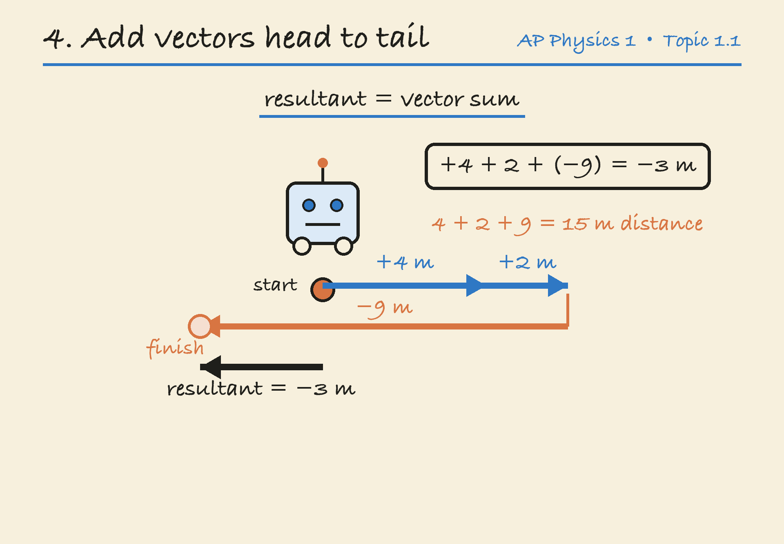
ANSWER 8
AP PHYSICS 1 1.1
Final practice: a robot on a straight track
(a) Head-to-tail lengths
4 cm right, 2 cm right,
then 9 cm left.
Resultant: 3 cm left.
(b) Resultant displacement
4 + 2 − 9 = −3 m.
Magnitude: 3 m, to the left.
(c) Distance and final position
Distance: 4 + 2 + 9 = 15 m.
Final position: +2 − 3 = −1 m.
Topic 1.1 / Final / Key and explanation
jimlaoshi.com
24
Notes:
AP Physics 1: Algebra-Based. Topic 1.1, Scalars and Vectors in One Dimension. College Board Course and Exam Description, effective Fall 2024, current ©2026 copy, Course Framework V.1, printed p.27 (PDF page34). Official source: https://apcentral.collegeboard.org/media/pdf/ap-physics-1-course-and-exam-description.pdf . Clarifications implemented Fall2026: https://apcentral.collegeboard.org/media/pdf/ap-physics-1-course-and-exam-description-clarifications.pdf . Relevant objectives 1.1.A and1.1.B. Numerical questions, examples and explanations are original Jimlaoshi teaching material, not official AP examination questions. Scope: one-dimensional vectors, scalar/vector classification, arrow representations, notation, signed components and sums. Rates of change, full kinematics calculations and two-dimensional resolution belong to later topics. Style reference: /Users/1mdollars/Desktop/Jimlaoshivideos/output/IAL_Physics_All_Hints_Labelled_20261023/deliverables/Jimlaoshi_IAL_Physics_1_2_2_Hints_Labelled.pptx. Illustration: D04_robot_head_to_tail_resultant.png. Existing Jimlaoshi AP Physics1 Topic1.1 visual supplied by the local course workspace. Original figure retained.

Slide 25
CONCEPT SUMMARY
AP PHYSICS 1 1.1
Scalars and vectors: key ideas
Idea | Meaning
Scalar | Magnitude only. Distance and speed.
Vector | Magnitude and direction. Velocity and acceleration.
Vector arrow | Length gives magnitude. Arrowhead gives direction.
Signed component | Sign gives direction along the chosen axis.
1D vector sum | The signed components add algebraically.
Return to start | Zero displacement can accompany a nonzero distance.
Hint: write the unit, state the direction, and check the sign convention.
Topic 1.1 / Summary
jimlaoshi.com
25
Notes:
AP Physics 1: Algebra-Based. Topic 1.1, Scalars and Vectors in One Dimension. College Board Course and Exam Description, effective Fall 2024, current ©2026 copy, Course Framework V.1, printed p.27 (PDF page34). Official source: https://apcentral.collegeboard.org/media/pdf/ap-physics-1-course-and-exam-description.pdf . Clarifications implemented Fall2026: https://apcentral.collegeboard.org/media/pdf/ap-physics-1-course-and-exam-description-clarifications.pdf . Relevant objectives 1.1.A and1.1.B. Numerical questions, examples and explanations are original Jimlaoshi teaching material, not official AP examination questions. Scope: one-dimensional vectors, scalar/vector classification, arrow representations, notation, signed components and sums. Rates of change, full kinematics calculations and two-dimensional resolution belong to later topics. Style reference: /Users/1mdollars/Desktop/Jimlaoshivideos/output/IAL_Physics_All_Hints_Labelled_20261023/deliverables/Jimlaoshi_IAL_Physics_1_2_2_Hints_Labelled.pptx.

Slide 26
SOURCES
AP PHYSICS 1 1.1
Topic scope and official sources
AP Physics 1: Algebra-Based
Topic 1.1: Scalars and Vectors in One Dimension
Learning objectives 1.1.A and 1.1.B.
College Board Course and Exam Description
Effective Fall 2024. Current ©2026 copy, Course Framework V.1, printed p.27.
Fall 2026 clarifications checked. Source links appear in the slide notes.
This lesson covers one-dimensional descriptions and vector sums. Detailed rates of change,
kinematics equations and two-dimensional components follow in later topics.
Questions and worked examples are original Jimlaoshi teaching materials.
Independent Jimlaoshi teaching resource
jimlaoshi.com
26
Notes:
AP Physics 1: Algebra-Based. Topic 1.1, Scalars and Vectors in One Dimension. College Board Course and Exam Description, effective Fall 2024, current ©2026 copy, Course Framework V.1, printed p.27 (PDF page34). Official source: https://apcentral.collegeboard.org/media/pdf/ap-physics-1-course-and-exam-description.pdf . Clarifications implemented Fall2026: https://apcentral.collegeboard.org/media/pdf/ap-physics-1-course-and-exam-description-clarifications.pdf . Relevant objectives 1.1.A and1.1.B. Numerical questions, examples and explanations are original Jimlaoshi teaching material, not official AP examination questions. Scope: one-dimensional vectors, scalar/vector classification, arrow representations, notation, signed components and sums. Rates of change, full kinematics calculations and two-dimensional resolution belong to later topics. Style reference: /Users/1mdollars/Desktop/Jimlaoshivideos/output/IAL_Physics_All_Hints_Labelled_20261023/deliverables/Jimlaoshi_IAL_Physics_1_2_2_Hints_Labelled.pptx.

