Slide 1
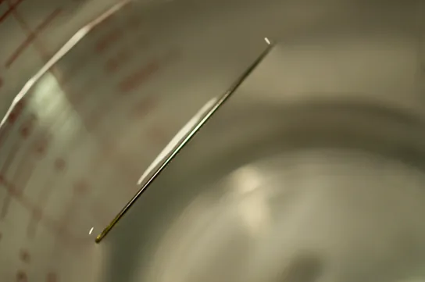
AP BIOLOGY / TOPIC 1.1
Structure of Water
and Hydrogen Bonding
Unit 1: Chemistry of Life
H₂O
Molecular structure
Water’s properties
Biological functions
Surface tension can support a needle.
LESSON INTRODUCTION
jimlaoshi.com
01
Notes:
Introduce water as a molecule whose structure explains its biological functions. This cover is an introduction, not a question.
Sources: College Board, AP Biology Course and Exam Description, effective Fall 2025, Course Framework V.1, Topic 1.1, printed p.32 (PDF p.39), LO 1.1.A, EK 1.1.A.1–1.1.A.2. https://apcentral.collegeboard.org/media/pdf/ap-biology-course-and-exam-description.pdf
Opening visual: needle supported on water, OpenStax Biology 2e section 2.2 Water, Figure 2.16, credit Cory Zanker. https://openstax.org/books/biology-2e/pages/2-2-water . This photograph introduces a surprising consequence of cohesion without changing the concept-practice-key lesson sequence. The needle is denser than water and is supported by surface tension when carefully placed.

Slide 2
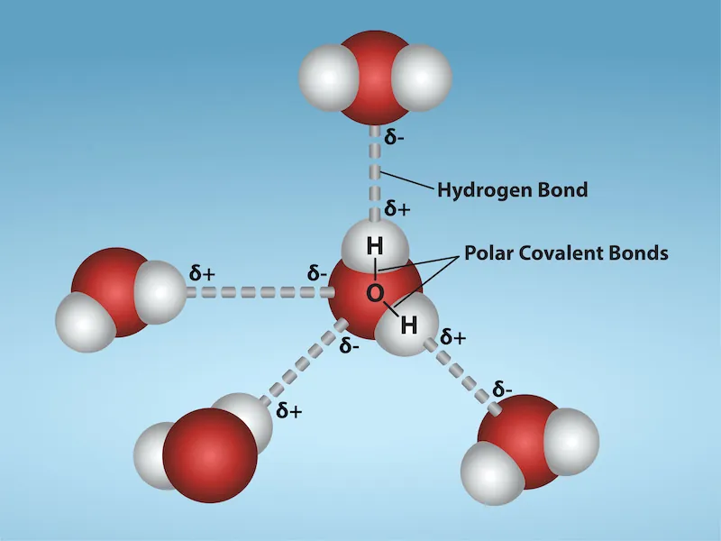
AP BIOLOGY / TOPIC 1.1
Polarity and partial charges
POLAR
An uneven distribution of electrical charge.
ELECTRONEGATIVITY
Attraction for shared electrons. Oxygen
attracts them more strongly than hydrogen.
PARTIAL CHARGE, δ
A small charge caused by unequal electron
sharing. O is δ−. Each H is δ+.
Water has a bent shape and no overall
charge.
PART 1 / CONCEPT
jimlaoshi.com
02
Notes:
Water has two H atoms and one O atom. Its bent shape means bond polarities do not cancel. Oxygen attracts shared electrons more strongly. The molecule remains electrically neutral. The exact bond angle is not required. Figure 2.13: Rao, Fletcher, Ryan, Tag and Hawkins, Texas A&M University, via OpenStax.
Sources: College Board, AP Biology Course and Exam Description, effective Fall 2025, Course Framework V.1, Topic 1.1, printed p.32 (PDF p.39), LO 1.1.A, EK 1.1.A.1–1.1.A.2. https://apcentral.collegeboard.org/media/pdf/ap-biology-course-and-exam-description.pdf
OpenStax Biology 2e, section 2.2 Water. https://openstax.org/books/biology-2e/pages/2-2-water

Slide 3
AP BIOLOGY / TOPIC 1.1
Reading a water molecule
A student says, “Oxygen is negative, so a water molecule must have
a negative overall charge.”
(a)
Give the meaning of δ− and δ+ in a water molecule.
(b)
Explain why electrons are shared unequally between O and H.
(c)
Correct the student’s claim about the whole molecule.
PART 1 / PRACTICE
jimlaoshi.com
03
Notes:
Original Jimlaoshi practice, not an official College Board question. Show the whole question before starting thinking time. For an MCQ, keep every option visible for at least six seconds. Allow longer for written parts. Do not advance to the key until students have attempted the task.
Sources: College Board, AP Biology Course and Exam Description, effective Fall 2025, Course Framework V.1, Topic 1.1, printed p.32 (PDF p.39), LO 1.1.A, EK 1.1.A.1–1.1.A.2. https://apcentral.collegeboard.org/media/pdf/ap-biology-course-and-exam-description.pdf

Slide 4
AP BIOLOGY / TOPIC 1.1
Polarity: key and explanation
(a)
δ− means partially negative. δ+ means partially positive. Oxygen has δ− and
each hydrogen has δ+.
(b)
Oxygen is more electronegative than hydrogen. It attracts the shared electrons
more strongly.
(c)
The water molecule has no net charge. Its charges are unevenly distributed, but
its total positive and negative charges balance.
PART 1 / KEY AND EXPLANATION
jimlaoshi.com
04
Notes:
Accept slightly or partially negative/positive. Reject full ionic charges. Oxygen has greater electronegativity. Unequal distribution of charge does not change the total number of protons and electrons in H2O.
Sources: College Board, AP Biology Course and Exam Description, effective Fall 2025, Course Framework V.1, Topic 1.1, printed p.32 (PDF p.39), LO 1.1.A, EK 1.1.A.1–1.1.A.2. https://apcentral.collegeboard.org/media/pdf/ap-biology-course-and-exam-description.pdf

Slide 5
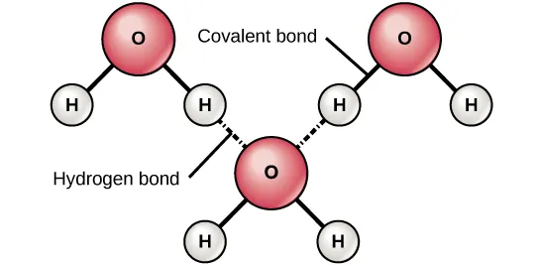
AP BIOLOGY / TOPIC 1.1
Covalent bonds and hydrogen bonds
POLAR COVALENT BOND
A bond with unequal sharing of electrons. The
O–H bonds within H₂O are polar covalent.
HYDROGEN BOND
A weak attraction involving a δ+ H bonded to O or
N and a nearby electronegative atom.
Solid lines: covalent bonds.
Dashes: hydrogen bonds.
Between molecules: hydrogen bonds help connect the two DNA strands.
Within one molecule: hydrogen bonds help stabilize a folded protein.
PART 2 / CONCEPT
jimlaoshi.com
05
Notes:
Hydrogen bonding can occur between separate biological molecules and between different parts of one biological molecule. DNA strand pairing and protein folding illustrate this distinction. In water, hydrogen bonds form between different water molecules. An individual hydrogen bond is weaker than an O–H covalent bond.
Sources: College Board, AP Biology Course and Exam Description, effective Fall 2025, Course Framework V.1, Topic 1.1, printed p.32 (PDF p.39), LO 1.1.A, EK 1.1.A.1–1.1.A.2. https://apcentral.collegeboard.org/media/pdf/ap-biology-course-and-exam-description.pdf
Added visual: OpenStax Concepts of Biology section 2.1 The Building Blocks of Molecules, Figure 2.7. https://openstax.org/books/concepts-biology/pages/2-1-the-building-blocks-of-molecules . Solid O–H bonds are polar covalent. Dashed O···H attractions link different water molecules. DNA and protein examples remain explicitly stated in editable text.

Slide 6
AP BIOLOGY / TOPIC 1.1
Identifying the bond
(a)
Name the bond between O and H within one water molecule.
(b)
Name the attraction between the δ+ H of one water molecule and the δ− O
of another.
(c)
Water evaporates. Which type of bond is disrupted? Do the escaping
particles remain H₂O?
PART 2 / PRACTICE
jimlaoshi.com
06
Notes:
Original Jimlaoshi practice, not an official College Board question. Show the whole question before starting thinking time. For an MCQ, keep every option visible for at least six seconds. Allow longer for written parts. Do not advance to the key until students have attempted the task.
Sources: College Board, AP Biology Course and Exam Description, effective Fall 2025, Course Framework V.1, Topic 1.1, printed p.32 (PDF p.39), LO 1.1.A, EK 1.1.A.1–1.1.A.2. https://apcentral.collegeboard.org/media/pdf/ap-biology-course-and-exam-description.pdf

Slide 7
AP BIOLOGY / TOPIC 1.1
Bond types: key and explanation
(a)
Polar covalent bond. O and H share electrons unequally.
(b)
Hydrogen bond. Opposite partial charges attract across two water molecules.
(c)
Hydrogen bonds between molecules are disrupted. The O–H covalent bonds
remain, so the vapor still contains H₂O molecules.
PART 2 / KEY AND EXPLANATION
jimlaoshi.com
07
Notes:
Hydrogen-bond interactions between molecules are disrupted during vaporization. Evaporation does not chemically decompose H2O. Do not imply all hydrogen atoms can form hydrogen bonds.
Sources: College Board, AP Biology Course and Exam Description, effective Fall 2025, Course Framework V.1, Topic 1.1, printed p.32 (PDF p.39), LO 1.1.A, EK 1.1.A.1–1.1.A.2. https://apcentral.collegeboard.org/media/pdf/ap-biology-course-and-exam-description.pdf

Slide 8
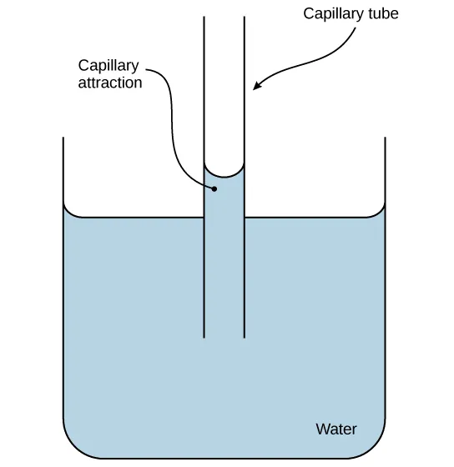
AP BIOLOGY / TOPIC 1.1
Cohesion and adhesion
COHESION
Attraction between molecules of the same
substance. Water attracts water.
ADHESION
Attraction between different substances. Water can
cling to a polar surface.
Xylem: the plant tissue that transports water and dissolved
minerals.
PART 3 / CONCEPT
jimlaoshi.com
08
Notes:
Adhesion is a water–surface interaction rather than water–water attraction. Water hydrogen-bonds with suitable polar surfaces. Transpiration provides tension pulling a cohesive xylem water column; capillary action alone does not explain water reaching the tops of tall trees. Figure 2.17: modification of work by Pearson-Scott Foresman, donated to Wikimedia Foundation.
Sources: College Board, AP Biology Course and Exam Description, effective Fall 2025, Course Framework V.1, Topic 1.1, printed p.32 (PDF p.39), LO 1.1.A, EK 1.1.A.1–1.1.A.2. https://apcentral.collegeboard.org/media/pdf/ap-biology-course-and-exam-description.pdf
OpenStax Biology 2e, section 2.2 Water. https://openstax.org/books/biology-2e/pages/2-2-water

Slide 9
AP BIOLOGY / TOPIC 1.1
Water moving through a plant
Water rises through the xylem as leaves lose water by evaporation.
(a)
Name the property that keeps water molecules connected in a continuous
column.
(b)
Name the property that helps water cling to the vessel wall.
(c)
State the molecular interaction responsible for attraction between
neighboring water molecules.
PART 3 / PRACTICE
jimlaoshi.com
09
Notes:
Original Jimlaoshi practice, not an official College Board question. Show the whole question before starting thinking time. For an MCQ, keep every option visible for at least six seconds. Allow longer for written parts. Do not advance to the key until students have attempted the task.
Sources: College Board, AP Biology Course and Exam Description, effective Fall 2025, Course Framework V.1, Topic 1.1, printed p.32 (PDF p.39), LO 1.1.A, EK 1.1.A.1–1.1.A.2. https://apcentral.collegeboard.org/media/pdf/ap-biology-course-and-exam-description.pdf

Slide 10
AP BIOLOGY / TOPIC 1.1
Water transport: key and explanation
(a)
Cohesion keeps the water molecules connected. The pull on one molecule can
transfer along the water column.
(b)
Adhesion helps water cling to the vessel wall. This is attraction between water
and another substance.
(c)
Hydrogen bonds form between the δ+ H of one molecule and the δ− O of a
neighboring molecule.
PART 3 / KEY AND EXPLANATION
jimlaoshi.com
10
Notes:
For part b distinguish attraction to the wall from water–water cohesion. Transpiration pull supplies tension. Do not credit a claim that adhesion alone pumps water up a tall tree.
Sources: College Board, AP Biology Course and Exam Description, effective Fall 2025, Course Framework V.1, Topic 1.1, printed p.32 (PDF p.39), LO 1.1.A, EK 1.1.A.1–1.1.A.2. https://apcentral.collegeboard.org/media/pdf/ap-biology-course-and-exam-description.pdf

Slide 11
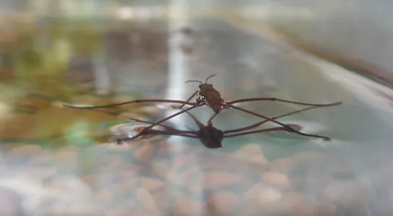
AP BIOLOGY / TOPIC 1.1
Surface tension
SURFACE TENSION
The tendency of a liquid surface to resist
stretching and an increase in area.
COHESION AT THE SURFACE
Hydrogen bonds hold surface water
molecules together.
PART 4 / CONCEPT
jimlaoshi.com
11
Notes:
At the water surface, molecules experience cohesive interactions with neighbors beside and below them. Surface tension is not a literal skin. A water strider’s legs distribute its weight and resist wetting. Photo: Tim Vickers, OpenStax Figure 2.18.
Sources: College Board, AP Biology Course and Exam Description, effective Fall 2025, Course Framework V.1, Topic 1.1, printed p.32 (PDF p.39), LO 1.1.A, EK 1.1.A.1–1.1.A.2. https://apcentral.collegeboard.org/media/pdf/ap-biology-course-and-exam-description.pdf
OpenStax Biology 2e, section 2.2 Water. https://openstax.org/books/biology-2e/pages/2-2-water

Slide 12
AP BIOLOGY / TOPIC 1.1
A water strider on a pond
Which property of water helps support a small water strider at the
pond surface?
A Adhesion to the xylem wall
B High specific heat capacity
C Surface tension
D Lower density of ice
Follow-up: explain how hydrogen bonding contributes.
PART 4 / PRACTICE
jimlaoshi.com
12
Notes:
Original Jimlaoshi practice, not an official College Board question. Show the whole question before starting thinking time. For an MCQ, keep every option visible for at least six seconds. Allow longer for written parts. Do not advance to the key until students have attempted the task.
Sources: College Board, AP Biology Course and Exam Description, effective Fall 2025, Course Framework V.1, Topic 1.1, printed p.32 (PDF p.39), LO 1.1.A, EK 1.1.A.1–1.1.A.2. https://apcentral.collegeboard.org/media/pdf/ap-biology-course-and-exam-description.pdf

Slide 13
AP BIOLOGY / TOPIC 1.1
Surface tension: key and explanation
C Surface tension
Hydrogen bonds create cohesion among surface water molecules. The surface
resists deformation and can help support a small insect.
A Adhesion concerns attraction to another surface.
B Specific heat concerns temperature change.
D Ice density explains why ice floats.
PART 4 / KEY AND EXPLANATION
jimlaoshi.com
13
Notes:
Correct C. Complete question and options must stay visible during thinking time. The follow-up tests the mechanism. Explain every distractor without presenting the named alternatives as impossible water properties.
Sources: College Board, AP Biology Course and Exam Description, effective Fall 2025, Course Framework V.1, Topic 1.1, printed p.32 (PDF p.39), LO 1.1.A, EK 1.1.A.1–1.1.A.2. https://apcentral.collegeboard.org/media/pdf/ap-biology-course-and-exam-description.pdf

Slide 14
AP BIOLOGY / TOPIC 1.1
High specific heat capacity
SPECIFIC HEAT CAPACITY
Energy needed to raise the temperature of 1 g of a substance by 1°C.
HIGH SPECIFIC HEAT
Much heat produces a relatively small temperature rise. Some energy disrupts
hydrogen-bond interactions.
HOMEOSTASIS
Maintenance of stable internal conditions. Water helps stabilize body temperature.
PART 5 / CONCEPT
jimlaoshi.com
14
Notes:
Specific heat can be expressed per gram or kilogram. Here use per gram. It is a property measured as energy per unit mass per degree, rather than simply total heat needed by any sample. Disrupting hydrogen-bond interactions absorbs energy. Do not say every hydrogen bond breaks before temperature can rise. Water supports body-temperature stability, while active physiological control also contributes.
Sources: College Board, AP Biology Course and Exam Description, effective Fall 2025, Course Framework V.1, Topic 1.1, printed p.32 (PDF p.39), LO 1.1.A, EK 1.1.A.1–1.1.A.2. https://apcentral.collegeboard.org/media/pdf/ap-biology-course-and-exam-description.pdf

Slide 15
AP BIOLOGY / TOPIC 1.1
The same energy, different warming
Equal masses of water and liquid X absorb the same amount of heat, with
no change of state.
Water warms by 2°C. Liquid X warms by 8°C.
(a)
Which liquid has the higher specific heat capacity?
(b)
How does hydrogen bonding help explain water’s response?
(c)
How can this property help a living organism?
PART 5 / PRACTICE
jimlaoshi.com
15
Notes:
Original Jimlaoshi practice, not an official College Board question. Show the whole question before starting thinking time. For an MCQ, keep every option visible for at least six seconds. Allow longer for written parts. Do not advance to the key until students have attempted the task. The data are an original idealized model, not measured results. Masses and starting temperatures are equal; each liquid absorbs the same heat; no change of state occurs.
Sources: College Board, AP Biology Course and Exam Description, effective Fall 2025, Course Framework V.1, Topic 1.1, printed p.32 (PDF p.39), LO 1.1.A, EK 1.1.A.1–1.1.A.2. https://apcentral.collegeboard.org/media/pdf/ap-biology-course-and-exam-description.pdf

Slide 16
AP BIOLOGY / TOPIC 1.1
Specific heat: key and explanation
(a)
Water. It absorbs the same heat per gram with a smaller temperature rise.
(b)
Some energy disrupts hydrogen-bond interactions. More energy is needed for a
given rise in temperature.
(c)
Water helps buffer changes in body temperature, supporting homeostasis.
PART 5 / KEY AND EXPLANATION
jimlaoshi.com
16
Notes:
The inference requires equal masses and equal absorbed energy. No numerical calculation is required. Specific heat, rather than heat of vaporization, is the relevant property because the samples remain liquid.
Sources: College Board, AP Biology Course and Exam Description, effective Fall 2025, Course Framework V.1, Topic 1.1, printed p.32 (PDF p.39), LO 1.1.A, EK 1.1.A.1–1.1.A.2. https://apcentral.collegeboard.org/media/pdf/ap-biology-course-and-exam-description.pdf

Slide 17
AP BIOLOGY / TOPIC 1.1
Heat of vaporization and cooling
HEAT OF VAPORIZATION
Energy needed to change 1 g of liquid into gas at a specified temperature. Water
has a high heat of vaporization.
EVAPORATION
The escape of molecules from a liquid surface into the gas phase.
EVAPORATIVE COOLING
A fall in temperature as evaporation carries energy away. Evaporating sweat helps
cool the body.
PART 6 / CONCEPT
jimlaoshi.com
17
Notes:
Water can evaporate below its boiling point. Hydrogen bonds between liquid water molecules must be overcome. Escaping molecules carry energy away and the skin supplies energy during evaporation. The molecular O–H covalent bonds remain. The remaining liquid and its surroundings cool.
Sources: College Board, AP Biology Course and Exam Description, effective Fall 2025, Course Framework V.1, Topic 1.1, printed p.32 (PDF p.39), LO 1.1.A, EK 1.1.A.1–1.1.A.2. https://apcentral.collegeboard.org/media/pdf/ap-biology-course-and-exam-description.pdf

Slide 18
AP BIOLOGY / TOPIC 1.1
Why does evaporating sweat cool skin?
Which explanation best accounts for cooling when sweat
evaporates?
A O–H covalent bonds split inside H₂O.
B Water becomes nonpolar in the air.
C Ice forms and lowers the skin temperature.
D Evaporating water carries energy away.
Follow-up: name the water property that makes this effective.
PART 6 / PRACTICE
jimlaoshi.com
18
Notes:
Original Jimlaoshi practice, not an official College Board question. Show the whole question before starting thinking time. For an MCQ, keep every option visible for at least six seconds. Allow longer for written parts. Do not advance to the key until students have attempted the task.
Sources: College Board, AP Biology Course and Exam Description, effective Fall 2025, Course Framework V.1, Topic 1.1, printed p.32 (PDF p.39), LO 1.1.A, EK 1.1.A.1–1.1.A.2. https://apcentral.collegeboard.org/media/pdf/ap-biology-course-and-exam-description.pdf

Slide 19
AP BIOLOGY / TOPIC 1.1
Evaporative cooling: key and explanation
D Evaporating water carries energy away.
Water has a high heat of vaporization. Energy is needed to overcome hydrogen
bonds as water molecules leave the liquid.
A The O–H covalent bonds remain intact.
B H₂O molecules remain polar in the gas phase.
C Evaporation changes liquid to gas, not to ice.
PART 6 / KEY AND EXPLANATION
jimlaoshi.com
19
Notes:
Correct D. High heat of vaporization makes the transfer of energy substantial per gram of evaporated water. Water remains chemically H2O and retains molecular polarity in the gas phase. Ice formation does not explain this scenario.
Sources: College Board, AP Biology Course and Exam Description, effective Fall 2025, Course Framework V.1, Topic 1.1, printed p.32 (PDF p.39), LO 1.1.A, EK 1.1.A.1–1.1.A.2. https://apcentral.collegeboard.org/media/pdf/ap-biology-course-and-exam-description.pdf

Slide 20
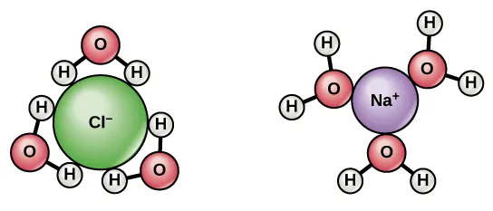
AP BIOLOGY / TOPIC 1.1
Ice and solvent properties
DENSITY
Mass per unit volume. An open hydrogen-bonded
structure makes ice less dense than liquid water.
SOLVENT
A substance that dissolves a solute. Polar water
interacts with many ions and polar substances.
Hydration of Cl⁻ and Na⁺
Oxygen faces positive ions. Hydrogen faces negative ions.
PART 7 / OPTIONAL CONCEPT
jimlaoshi.com
20
Notes:
These are useful related properties from the original deck, beyond the properties explicitly named in the current Topic 1.1 required-content list. Ice has an open hydrogen-bonded structure. A floating ice layer insulates water below, though not all lakes remain liquid indefinitely. Water dissolves many ions and polar molecules, but not everything. Ion–water interactions are ion–dipole attractions and should not all be called hydrogen bonds.
Sources: OpenStax Biology 2e, section 2.2 Water. https://openstax.org/books/biology-2e/pages/2-2-water
Scope: College Board, AP Biology Course and Exam Description, effective Fall 2025, Course Framework V.1, Topic 1.1, printed p.32 (PDF p.39), LO 1.1.A, EK 1.1.A.1–1.1.A.2. https://apcentral.collegeboard.org/media/pdf/ap-biology-course-and-exam-description.pdf
Added visual: OpenStax Biology 2e section 2.2 Water, Figure 2.15. https://openstax.org/books/biology-2e/pages/2-2-water . Left: partial positive H ends face Cl−. Right: partial negative O ends face Na+. These are ion–dipole attractions, not hydrogen bonds to the ions. This slide remains optional related context beyond the named current Topic 1.1 properties.

Slide 21
AP BIOLOGY / TOPIC 1.1
Floating ice and dissolved salt
(a)
Explain why ice floats and how a floating layer can benefit aquatic
organisms in winter.
(b)
When water surrounds Na⁺, which end of each water molecule faces the
ion? Explain.
(c)
Which end faces Cl⁻?
PART 7 / OPTIONAL PRACTICE
jimlaoshi.com
21
Notes:
Original Jimlaoshi practice, not an official College Board question. Show the whole question before starting thinking time. For an MCQ, keep every option visible for at least six seconds. Allow longer for written parts. Do not advance to the key until students have attempted the task. This optional cycle does not add named essential-knowledge requirements to Topic 1.1.
Sources: College Board, AP Biology Course and Exam Description, effective Fall 2025, Course Framework V.1, Topic 1.1, printed p.32 (PDF p.39), LO 1.1.A, EK 1.1.A.1–1.1.A.2. https://apcentral.collegeboard.org/media/pdf/ap-biology-course-and-exam-description.pdf

Slide 22
AP BIOLOGY / TOPIC 1.1
Related properties: key and explanation
(a)
Ice has an open hydrogen-bonded structure and a lower density than liquid
water. Floating ice insulates the water beneath it.
(b)
The oxygen end faces Na⁺. Its partial negative charge attracts the positive ion.
(c)
The hydrogen ends face Cl⁻. Their partial positive charges attract the negative
ion.
PART 7 / OPTIONAL KEY AND EXPLANATION
jimlaoshi.com
22
Notes:
Na+ and Cl− hydration involves ion–dipole attractions. This does not make the partial charges on water full ionic charges.
Sources: OpenStax Biology 2e, section 2.2 Water. https://openstax.org/books/biology-2e/pages/2-2-water

Slide 23
AP BIOLOGY / TOPIC 1.1
Water’s properties and biological functions
Cohesion
Keeps water molecules connected
Adhesion
Helps water cling to suitable surfaces
Surface tension
Helps support small objects at the surface
High specific heat
Helps buffer body temperature changes
High heat of vaporization
Enables evaporative cooling
For each function, connect polarity and hydrogen bonding to the property.
REVIEW
jimlaoshi.com
23
Notes:
Ask learners to choose a required property and give a complete explanation linking a molecular feature to a biological function. A list of terms alone does not explain the relationship.
Sources: College Board, AP Biology Course and Exam Description, effective Fall 2025, Course Framework V.1, Topic 1.1, printed p.32 (PDF p.39), LO 1.1.A, EK 1.1.A.1–1.1.A.2. https://apcentral.collegeboard.org/media/pdf/ap-biology-course-and-exam-description.pdf

Slide 24
AP BIOLOGY / TOPIC 1.1
Sources and lesson scope
COLLEGE BOARD
AP Biology Course and Exam Description, effective Fall 2025. Topic 1.1, printed p.32. LO
1.1.A and EK 1.1.A.1–1.1.A.2.
OPENSTAX
Biology 2e, section 2.2 Water. Concepts of Biology, section 2.1.
Figure credits and links are in the slide notes.
Part 7 is optional related context.
Practice questions and model data are original Jimlaoshi materials.
SOURCES
jimlaoshi.com
24
Notes:
Primary alignment: current official College Board CED and its corrections, including June 2026 updates. No separate current official public Topic 1.1 study guide was identified. The CED Unit 1 guide supplies the official content requirements. Original questions and model data are independent Jimlaoshi teaching materials.
Sources: College Board, AP Biology Course and Exam Description, effective Fall 2025, Course Framework V.1, Topic 1.1, printed p.32 (PDF p.39), LO 1.1.A, EK 1.1.A.1–1.1.A.2. https://apcentral.collegeboard.org/media/pdf/ap-biology-course-and-exam-description.pdf
Additional visual sources: OpenStax Biology 2e section 2.2 Water Figures 2.15 (ion hydration) and 2.16 (needle on water, credit Cory Zanker), and OpenStax Concepts of Biology section 2.1 Figure 2.7 (hydrogen bonding). Sources accessed 2026-10-20.

